Slide 1
AQUABOTS Aeropak
Critical Design Review
Team 26061

Slide 2
Contents
1.0 Introduction
2.0 System Requirements
3.0 Point Design
4.0 Performance Analyses and Expectations
5.0 Verification
6.0 Risk Analysis
7.0 Project Status and Plan
8.0 CDE 1
9.0 CDE 2
10.0 Cost Analysis and Deliverables
11.0 Summary
Notes:
Jamie

Slide 3
Introduction

Slide 4
Our Team
Jamie Ledbetter, Biosystems Engineering – Team Lead
Robert Wilkie, Aerospace Engineering – Procurement Lead
Alex Imrich, Aerospace Engineering
John Lopez, Electrical Engineering
Mayra Mendoza, Optical Engineering
Kama Henriques, Mechanical Engineering

Slide 5
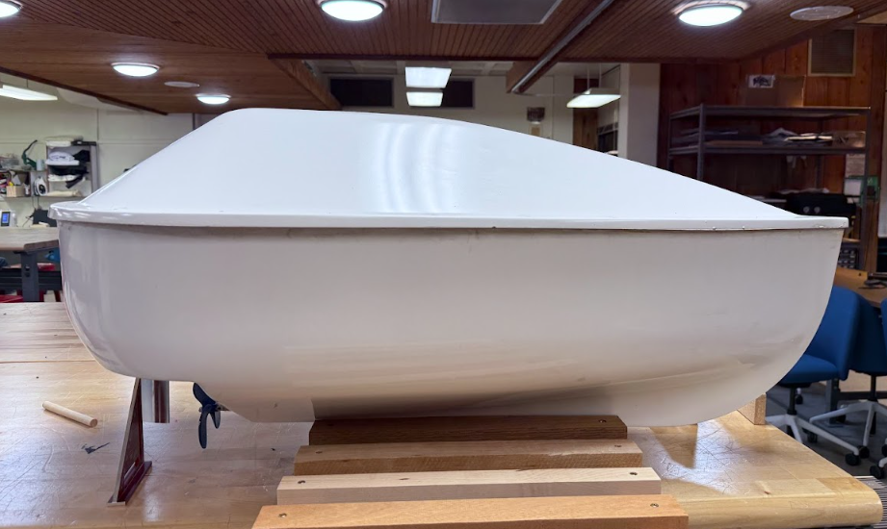
Project Summary
What makes AQUABOT different?
Rapid-response
Short-term, targeted missions
Swarm control capabilities
Scalable
Key Features:
Mounted and fully functional sensor/camera suite
Further developed communications
Easy Integration with other water vessels
Sponsors: Dr. Marvin Slepian, Eddy Stocker
Image of AQUABOT Hull
Notes:
Kama

Slide 6

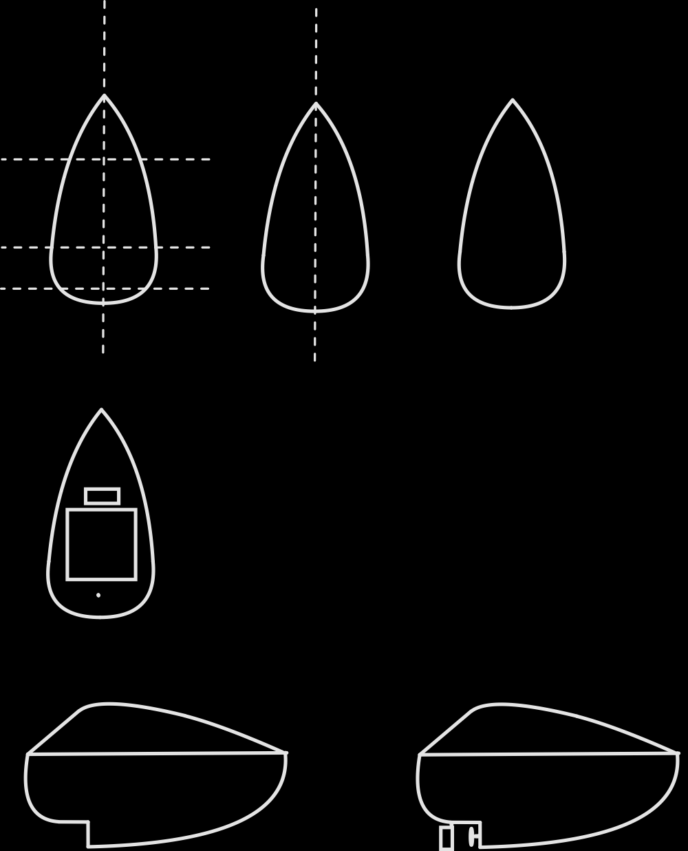
Project Summary: OV-1
Application:
Deployable in lakes and the ocean
Remote data acquisition and swarm command
Satellite
input transmission
feed transmission
command input
Starlink communication
video and data
User
PC with GUI
RC boat drones
Starlink-equipped drone
radio communication
radio communication
AQUABOT swarm in body of water
Notes:
Kama

Slide 7
PDR Action Items
Action Items
Add a system requirement for drone to drone communication
Add a system requirement for swarm control
Update SBD
Generate a weight analysis
Define/resolve deployment system approach with your sponsor
Action Taken
Created Requirement 5.4.2 for inter-drone communication up to 100m
Created Requirement 5.4.6 for coordinated drone swarm behavior with a leader-follower model at < 1 s latency
Updates made to SBD:
  Modification to reflect finalized motor and prop layout
  Removal of in-drone E-stop and Master Switch
Weight Analysis conducted to find total drone mass of ~37 kg
Team negotiation and discussion with sponsors resulted in a change of focus from deployment system to swarm demonstration
All Action Items Closed
Notes:
Jamie, “all action items closed” (RESOLVED)

Slide 8
Major Post-PDR Changes
Deployment system is no longer within the scope of the project
Shift of project focus to showcasing swarm behavior and control
At least three drones must be deployed
Requirements including speed, battery life, and internal volume have been altered to include a threshold value and objective value
Notes:
Jamie

Slide 9
System Requirements

Slide 10
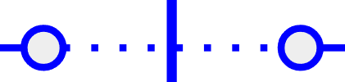
System Block Diagram:
Drone Hull
Waterproof IP68, Integrated Self-Righting System
Starlink Mini
(Antenna + Router)
48V Boost Converter
Battery
(24V LiFePO₄)
BMS
POWER
COMMUNICATION
+/- Bus
Ethernet
WebRTC
Uplink
(Video +
Commands)
SENSOR
5V Buck Converter
19V Buck Converter
PROPULSION
3.3 V & GPIO
ESP32
UART
Jetson Orin Nano +
Local Storage
(Encoded Video + Telemetry Logs)
GROUND STATION
Satellite
WebRTC
Uplink
(Video +
Commands)
(PWM)
5V (3-pin)
24V (XT-60)
3.3V
Temperature
Sensor
CSI Ribbon
POWER CONNECTION
Rudder Servo
ESC
User Interface and Control
Salinity Sensor
24V (3-phase)
IMX219
(Surface)
Brushless Motor
DATA CONNECTION
Starlink Terminal
Laptop
Internet Connection
PH Sensor
Live-video
Streaming
GUI
GEO- Overlay
Rudder
Propeller
No-connect Crossover
Notes:
Jamie

Slide 11
System Block Diagram Cont.:
RC Boat Hull
Battery
(24V LiFePO₄)
BMS
POWER
COMMUNICATION
+/- Bus
SENSOR
5V Buck Converter
5V Buck Converter
PROPULSION
3.3 V & GPIO
ESP32
Raspberry Pi
GROUND STATION
MQTT
Temperature
Sensor
POWER CONNECTION
Command Drone
Rudder Servo
ESC
Salinity Sensor
ESP32
Brushless Motor
DATA CONNECTION
PH Sensor
Rudder
Propeller
No-connect Crossover
Notes:
Jamie

Slide 12
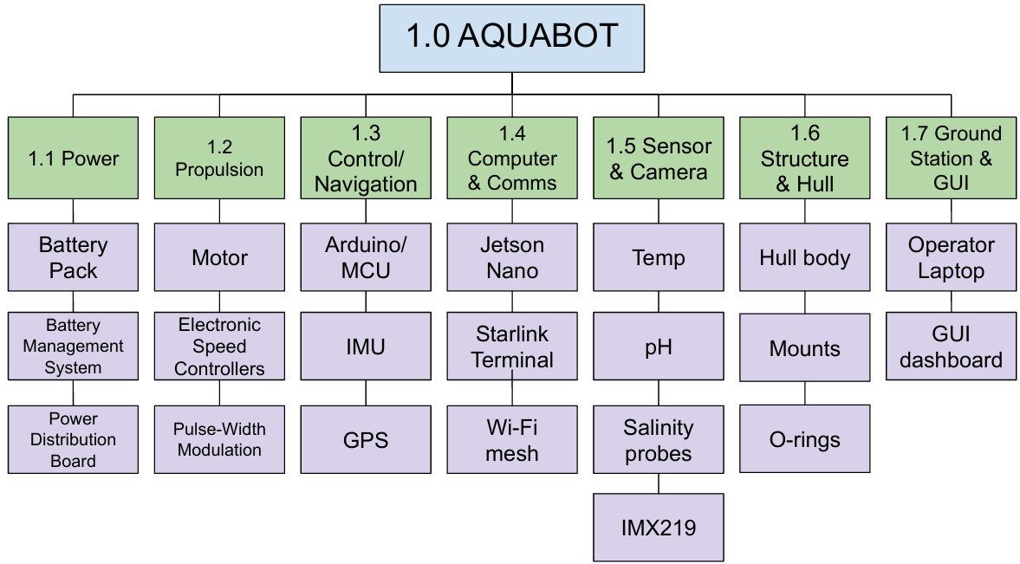
System Architecture
Notes:
Jamie

Slide 13
Key Performance Requirements
Swarm Deployment: All drones shall autonomously self-right and enter operational state within 60s of impact.
Stability: Each drone shall self-right and maintain operational orientation IAW UNE-EN ISO 12217-3:2022 and/or ASTM F3052-14(2020)e1.
Speed: Each drone shall be able to sustain a threshold speed of 2.5 kts in calm water conditions, with an objective speed of 5 kts.
Battery Life: Each drone shall reach a threshold runtime of 6 minutes at nominal load, with an objective value of 5 hours.
Data Collection: Each drone shall measure temperature, salinity, pH and capture visual imagery at a minimum of 1080p resolution, 30 fps.
Data Mapping: Each drone shall generate a georeferenced map of collected environmental variables and export data in GIS-compatible format.
Notes:
Jamie

Slide 14
System Requirements Verification Matrix (SRVM)
Requirement Type | Requirement | Verification Method
 |  | Test | Analysis | Demonstration | Inspection
4.1 Performance Requirements | 4.1.2 Swarm Control |  |  | X
 | 4.1.3 Stability | X |  | X
 | 4.1.4 Speed | X
 | 4.1.5 Battery Life | X | X
 | 4.1.6 Data Collection | X |  | X
 | 4.1.7 Data Mapping |  | X
4.2 Design Requirements | 4.2.1 Hull Shape |  | X
 | 4.2.2 Internal Volume |  | PASS |  | PASS
 | 4.2.3 Materials |  |  |  | X
 | 4.2.4 Payload Mounts |  |  | X | X
Notes:
Kama

Slide 15
SRVM Cont.
Requirement Type | Requirement | Verification Method
 |  | Test | Analysis | Demonstration | Inspection
4.3 Environmental Requirement | 4.3.1 Survivability | X | X
 | 4.3.2 Waterproofing | X |  |  | X
 | 4.3.3 Operating temperature | X | X
 | 4.3.4 Non-Hazardous Surface |  |  |  | PASS
4.4 Interface Requirements | 4.4.1 Autonomy & Control |  |  | PARTIAL PASS
 | 4.4.2 Inter-Drone Communication | PARTIAL PASS |  | X
 | 4.4.4 Satellite Uplink | PASS |  | PASS
 | 4.4.5 Display |  |  | PARTIAL PASS | PASS
Notes:
Kama

Slide 16
Point Design

Slide 17
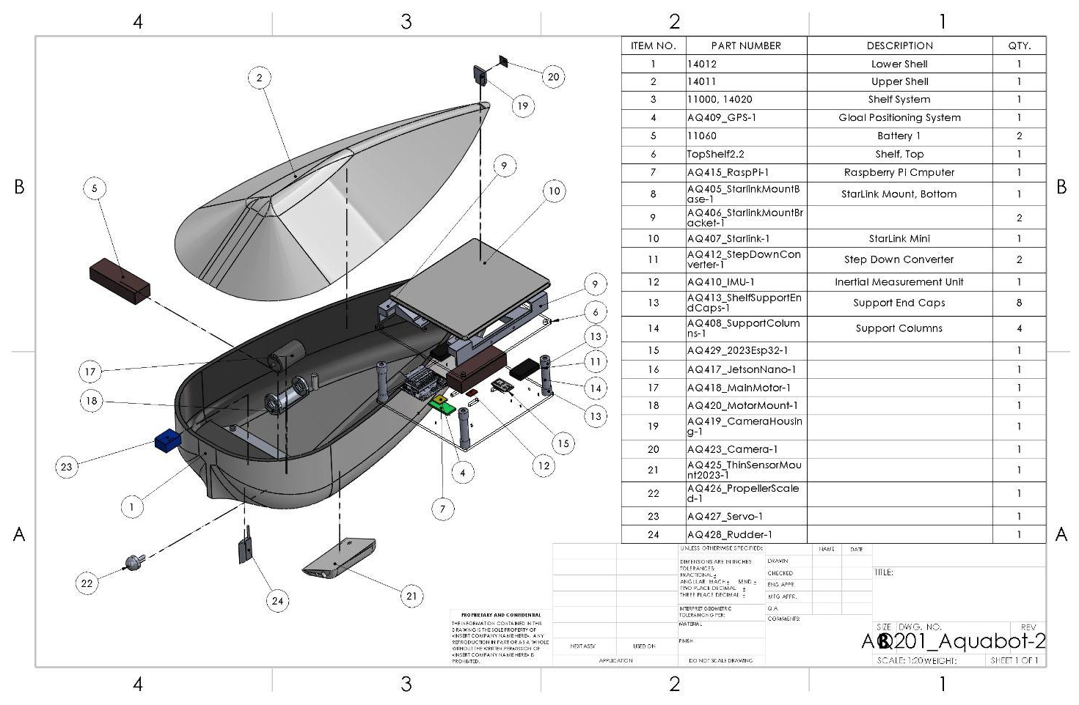
Assembly Drawing

Slide 18
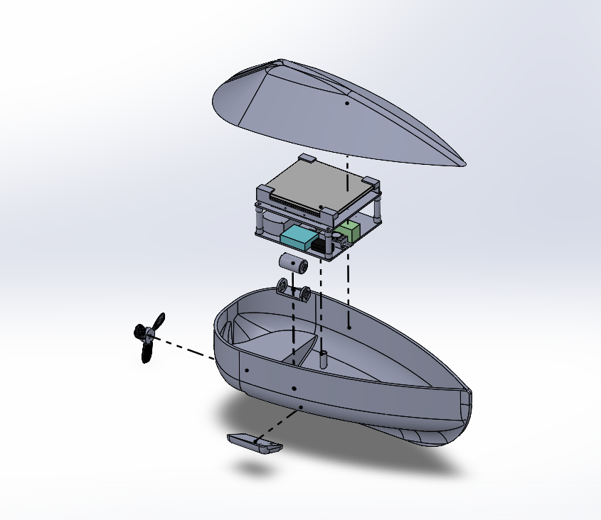
Exploded SolidWorks Assembly
Notes:
Alex,

Slide 19
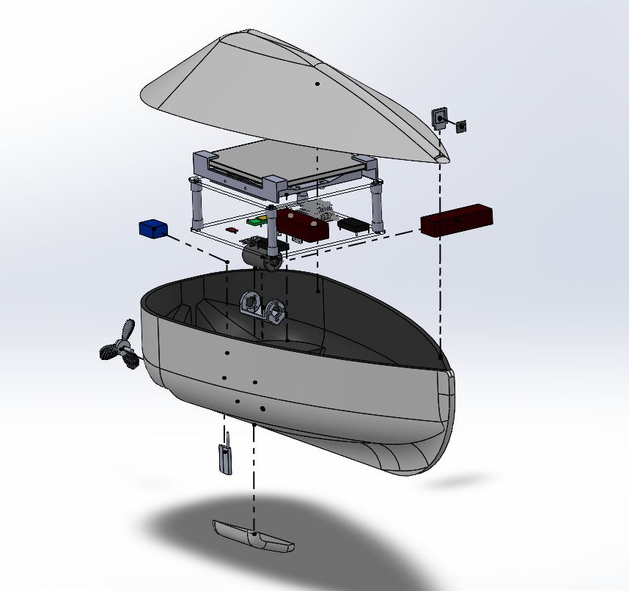
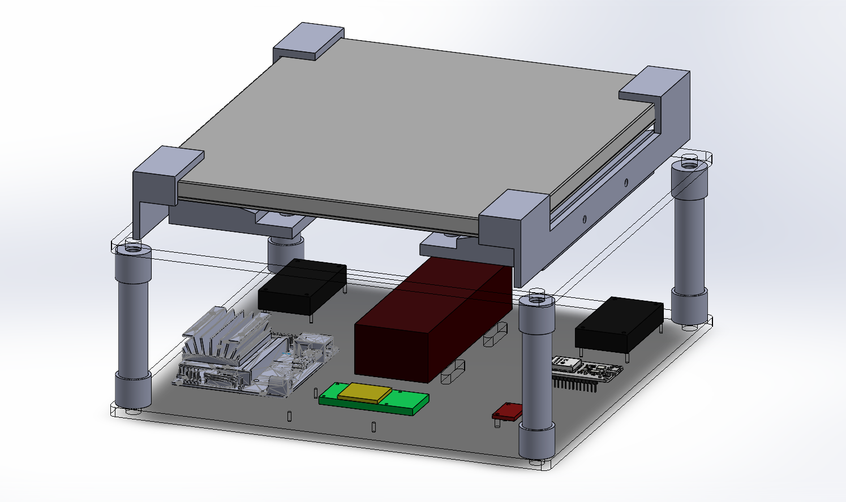
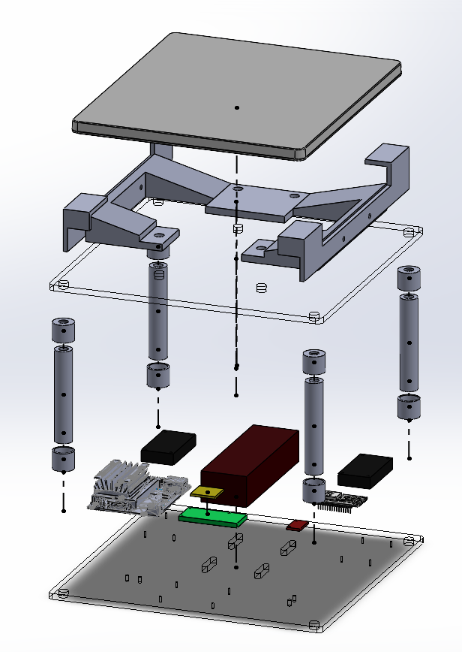
*Updated electronics:
Starlink
Jetson Nano
ESP32
Battery

Slide 20
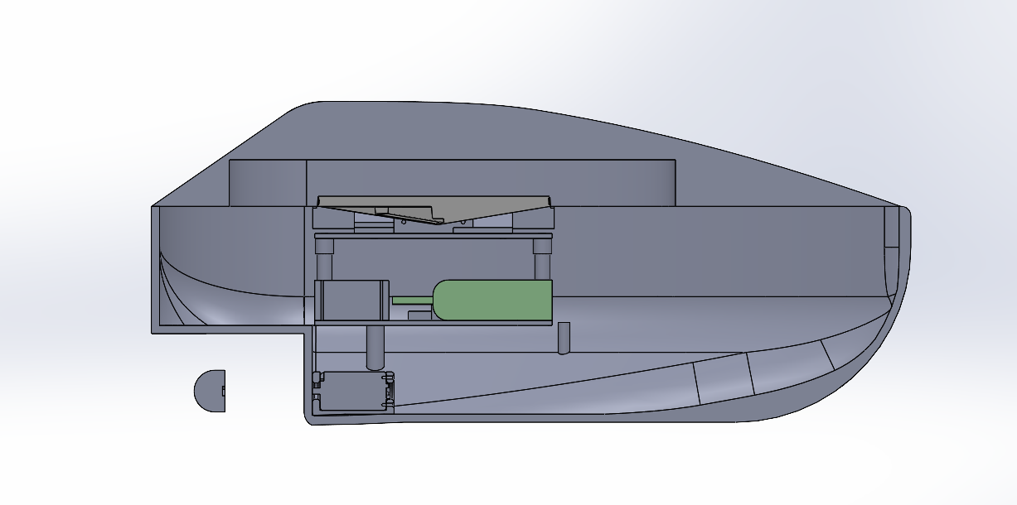
Exploded SolidWorks Assembly
Notes:
Alex,

Slide 21
Parts Guide for CAD
Part Number | Part Name | Rev Number | Status
1 | CompletePart | 1 | Complete
2 | WIPPart | 1 | WIP
3 | ObsoletePart | 1 | OBS
4 | To-DoPart | 1 | To-Do
201 | Aquabot | 1 | Complete
202 | ShelfAssem | 1 | Complete
203 | StarlinkMount | 1 | Complete
401 | BottomShell | 1 | Complete
402 | TopShell | 1 | Complete
403 | BottomShelf | 1 | Complete
404 | TopShelf | 1 | Complete
405 | StarlinkMountBase | 1 | Complete
406 | StarlinkMountBracket | 1 | Complete
407 | Starlink | 1 | Complete
408 | SupportColumns | 1 | Complete
Part Number | Part Name | Rev Number | Status
409 | GPS | 1 | Complete
410 | IMU | 1 | Complete
411 | VerticalSupports | 1 | Complete
412 | StepDownConverter | 1 | Complete
413 | ShelfSupportEndCaps | 1 | Complete
414 | ShelfSpacer | 1 | Complete
415 | RaspPi | 1 | Complete
416 | LiPO | 1 | Complete
417 | JetsonNano | 1 | Complete
418 | MainMotor | 1 | Complete
419 | CameraHousing | 2 | Complete
420 | MotorMount | 1 | Complete
421 | Battery | 1 | Complete
422 | RCMiniPiMount | 1 | Complete
501 | GoPro | 1 | OBS
Notes:
Alex

Slide 22
Software Subsystem

Slide 23

Operator GUI
Mission Controller
Commands
Cloud / Ground Station
Mission Logic
(ROS2)
Video encode / telemetry
System health & data logger
Telemetry
Flight Controller
Sensor data collection
Peer comms (ESP-NOW)
E-stop + failsafe logic
Real-time motor control
Sensor Data
Control signals
Sensors + Actuators
Sensor Suite
IMU
GPS
Rudder
Motor

Slide 24
Swarm Architecture
Decentralized Mesh Network (Communication)
Protocol: ESP-NOW (IEEE 802.11 Action Frames). Operates at Layer 2 (MAC) for connectionless, router-free communication.
"Any-to-Any" Routing: Implements a custom Flooding Algorithm with TTL=3 (Time-To-Live).
  Logic: Packets are re-broadcast by neighbor drones, creating dynamic relay paths if the direct Line-of-Sight is blocked by waves.
Performance Verification:
  Latency: < 10 ms (Verified). This is 10x faster than the system reaction time requirement, enabling real-time collision avoidance.
  Throughput: 50 packets/sec verified (Sufficient for 10 Hz control loop).
Content Block 2: Formation & Control Logic (Autonomy)
Strategy: "Virtual Rigid Body". The swarm treats the Leader as the origin point (0,0) and moves as a single fixed coordinate frame.
Position Algorithm:
  Follower derives target using:
  (Where is the Leader's heading rotation matrix).
Control Loop:
  PID Controller: Drives motor thrust to zero out the Distance_Error.
  Failsafe: If data age > 3.0s, logic switches to "Station Keep" (Hold GPS Position) until the mesh heels.
Global Waypoint
(Starlink)
Leader Drone Receives Waypoint
Broadcast via ESP-NOW
[GPS, Heading, Speed]
Follower Drone Calculates Target (Leader_pos + Offset_Vector)
PID Controller
(Drives motors to minimize error)
Notes:
John

Slide 25
Power Subsystem

Slide 26
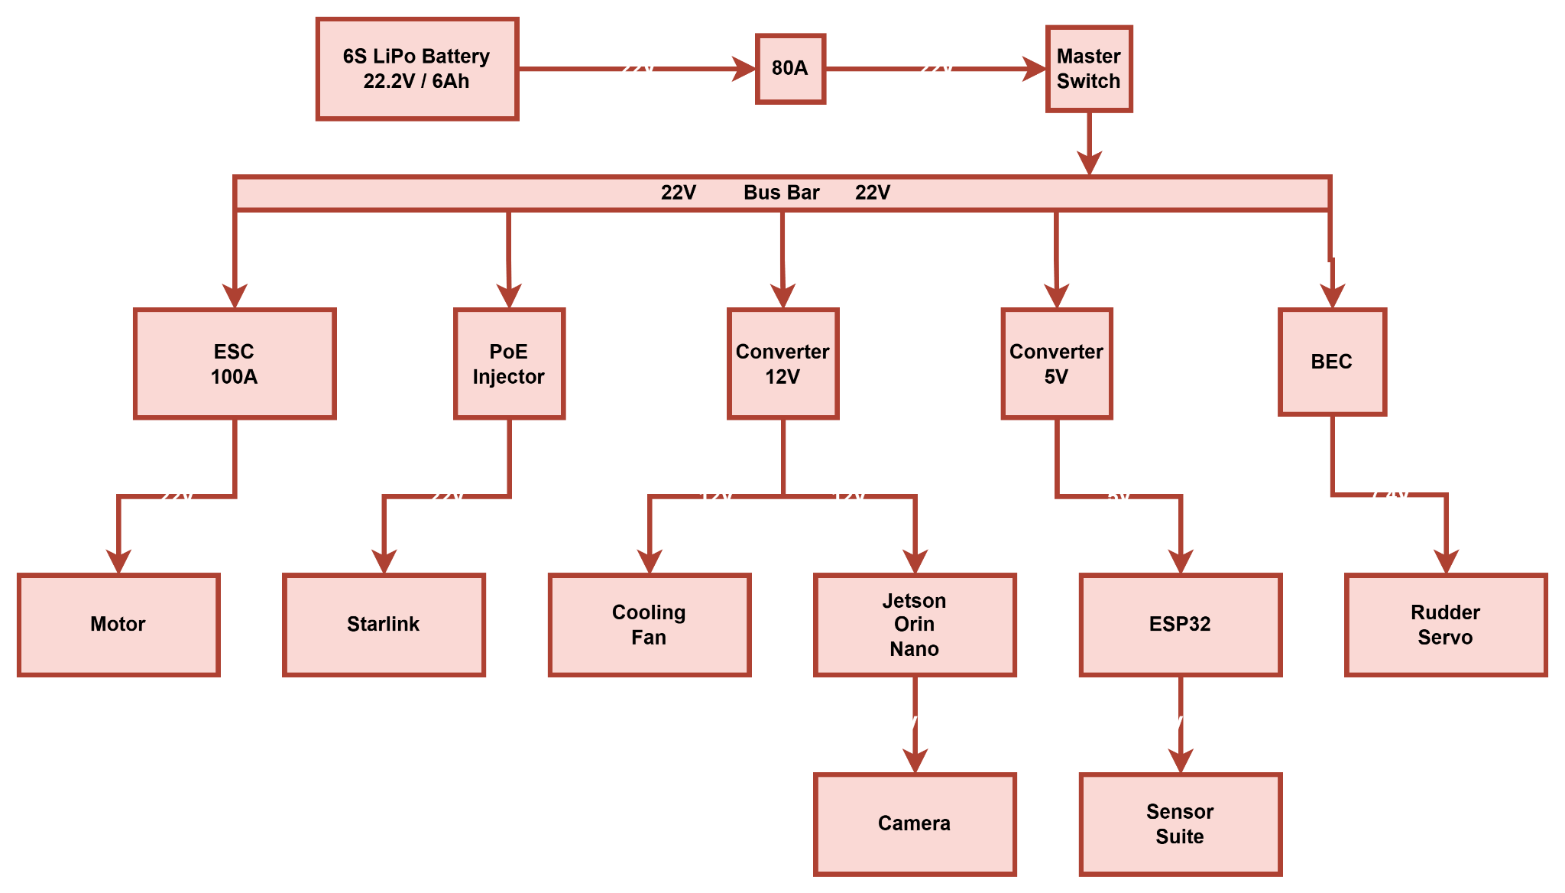
Block Diagram
Notes:
John,

Slide 27
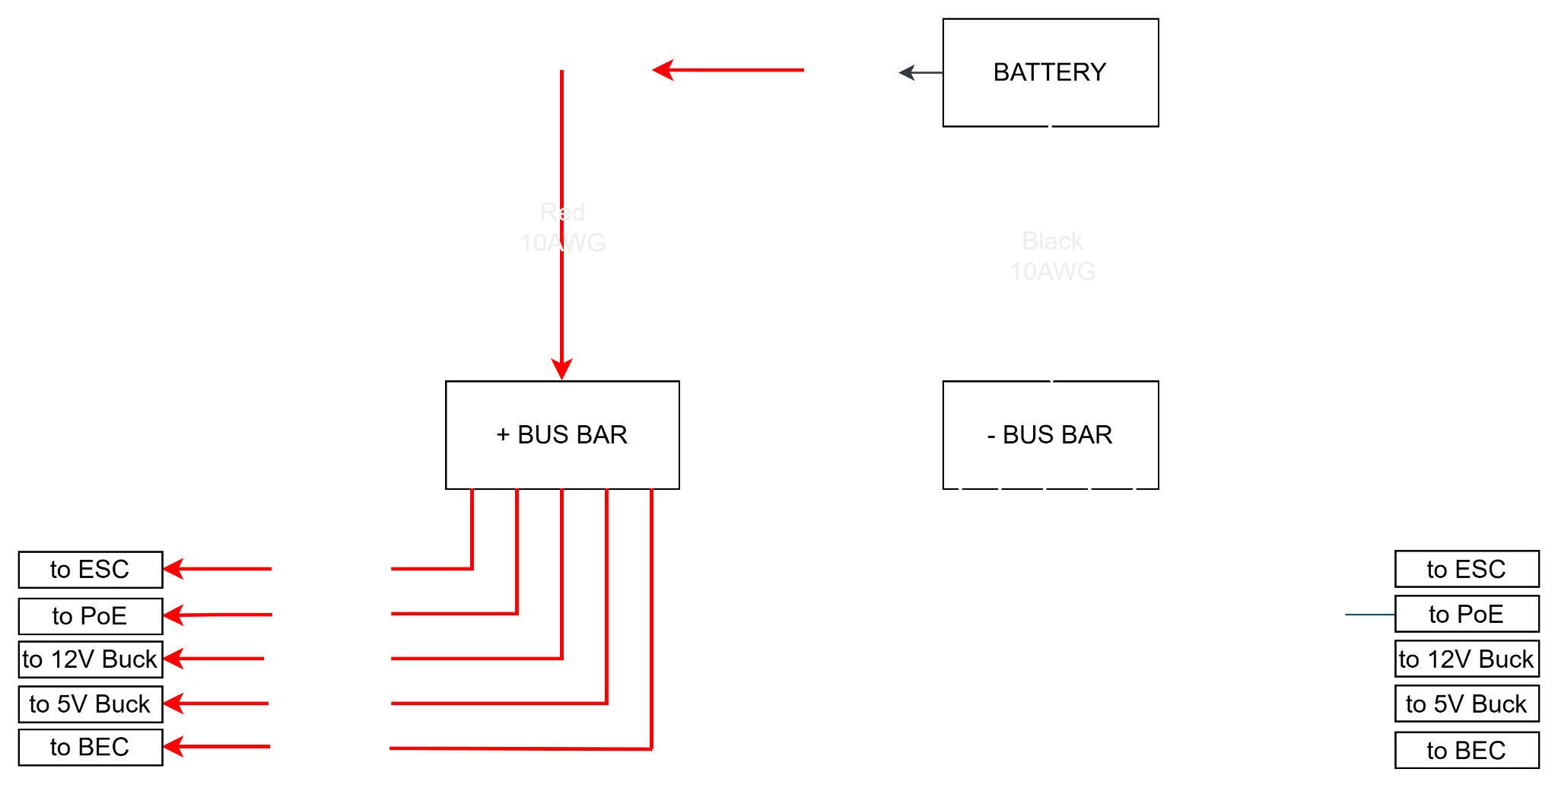
Wiring Diagram

Slide 28
Power Budget
Subsystem | Component | Voltage Rail | Max Power (Load) | Efficiency Loss | Total Power (from Battery) | Max Current (from Battery) | Cruise Power (from Battery)
Subsystem | Component | Voltage Rail | Max Power (Load) | Efficiency Loss | Total Power (from Battery) | Max Current (from Battery) | Cruise Power (from Battery)
Propulsion | Apisqueen 5080 Motor | 22.2 V | 1200 W | 0 W (Direct) | 1200.0 W | 54.0 A | 60.0 W
Comms | Starlink Gen 3 (via Yaosheng) | 57 V | 100 W | ~5 W (95%) | 105.0 W | 4.7 A | 70.0 W
Compute | Jetson Orin Nano + Fan | 12 V | 25 W | ~3 W (90%) | 28.0 W | 1.3 A | 15.0 W
Control | ESP32 + Rudder Servo | 5V / 7.4V | 20 W | ~2 W (90%) | 22.0 W | 1.0 A | 5.0 W
Payload | Sensors (GPS, IMU, Env) | 3.3 V | 5 W | ~1 W (85%) | 6.0 W | 0.3 A | 5.0 W
TOTALS |  |  | 1350 W |  | ~1361 W | ~61.3 A | ~155 W
Battery Capacity: | Ovonic 6S LiPo (22.2V, 6000mAh) = 133.2 Wh
Cruise Endurance: | 133.2 Wh / 155 W ≅ 0.85 Hours (51 Minutes)
Safety Margin: | Max draw is 61.3A, well within the 80A main fuse and the battery's 120C (720A) discharge limit.
Notes:
John

Slide 29
Communication Subsystem

Slide 30
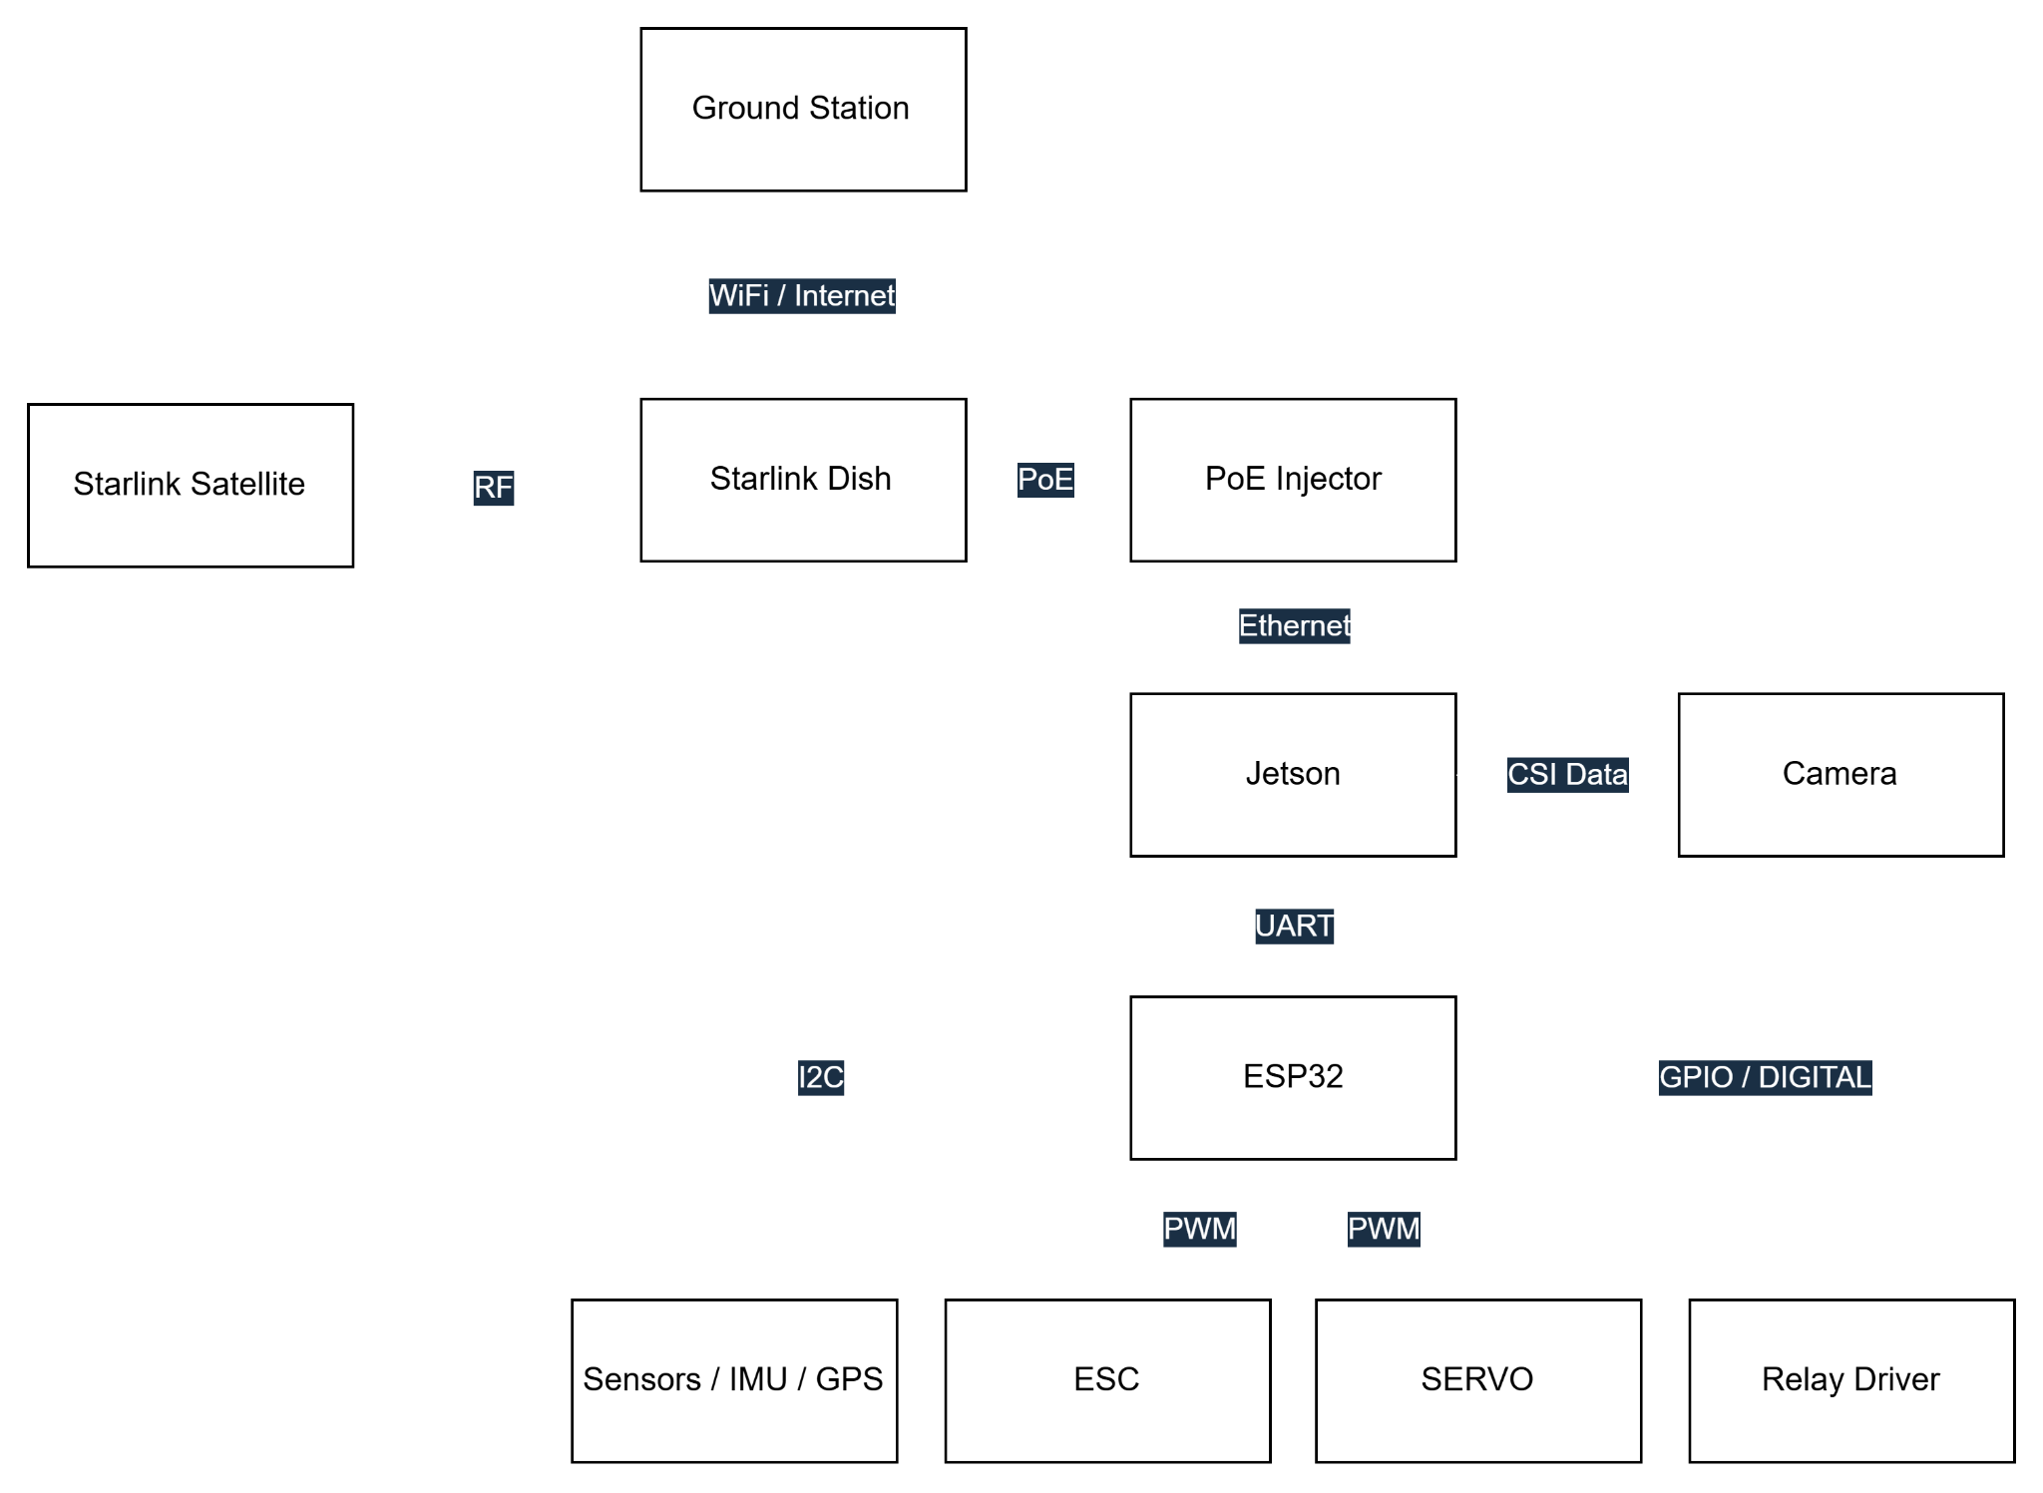
Communications
Block Diagram

Slide 31
Gateway and Swarm Topology
Hybrid Star-Mesh will utilize a "Gateway & Swarm" architecture to minimize cost while maximizing range.
Ground
Station
Starlink Satellite
Feature | Main Drone (Gateway) | Follower Drones (Swarm)
Role | Central Hub & Internet Bridge | Data Collection Node
Uplink | Starlink (Marine Terminal) | None (Relays to Main)
Local Link | ESP-NOW (Rx/Tx) | ESP-NOW (Tx to Main)
Hardware | Jetson Nano + ESP32 | Raspberry Pi + ESP32
Data Flow | Aggregates all swarm data → Cloud | Sensors →Main Drone
Starlink
Sensors
Jetson
Raspberry Pi
ESP32
ESP32
Notes:
John

Slide 32
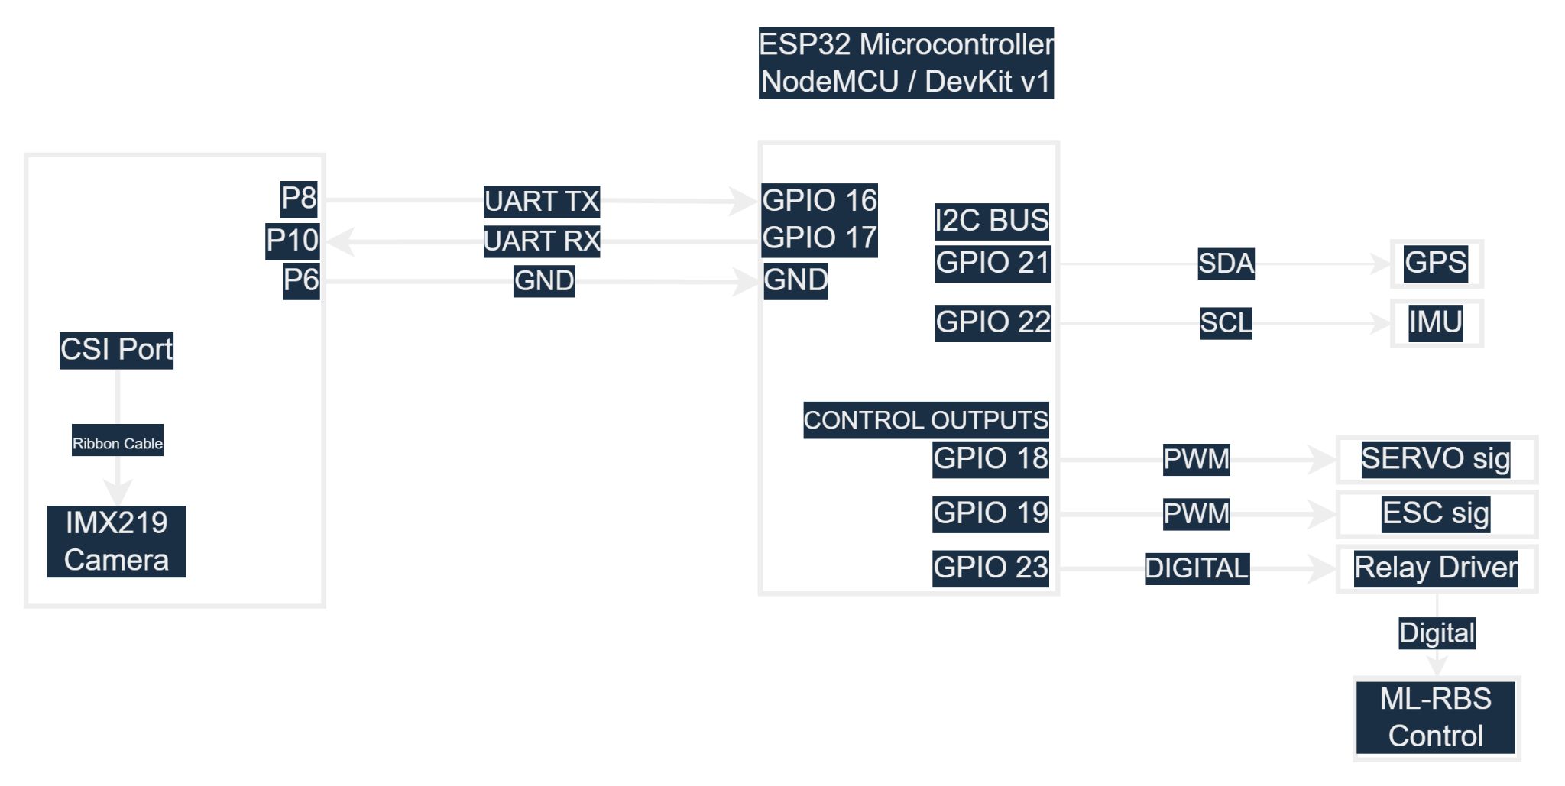
Wiring Diagram

Slide 33
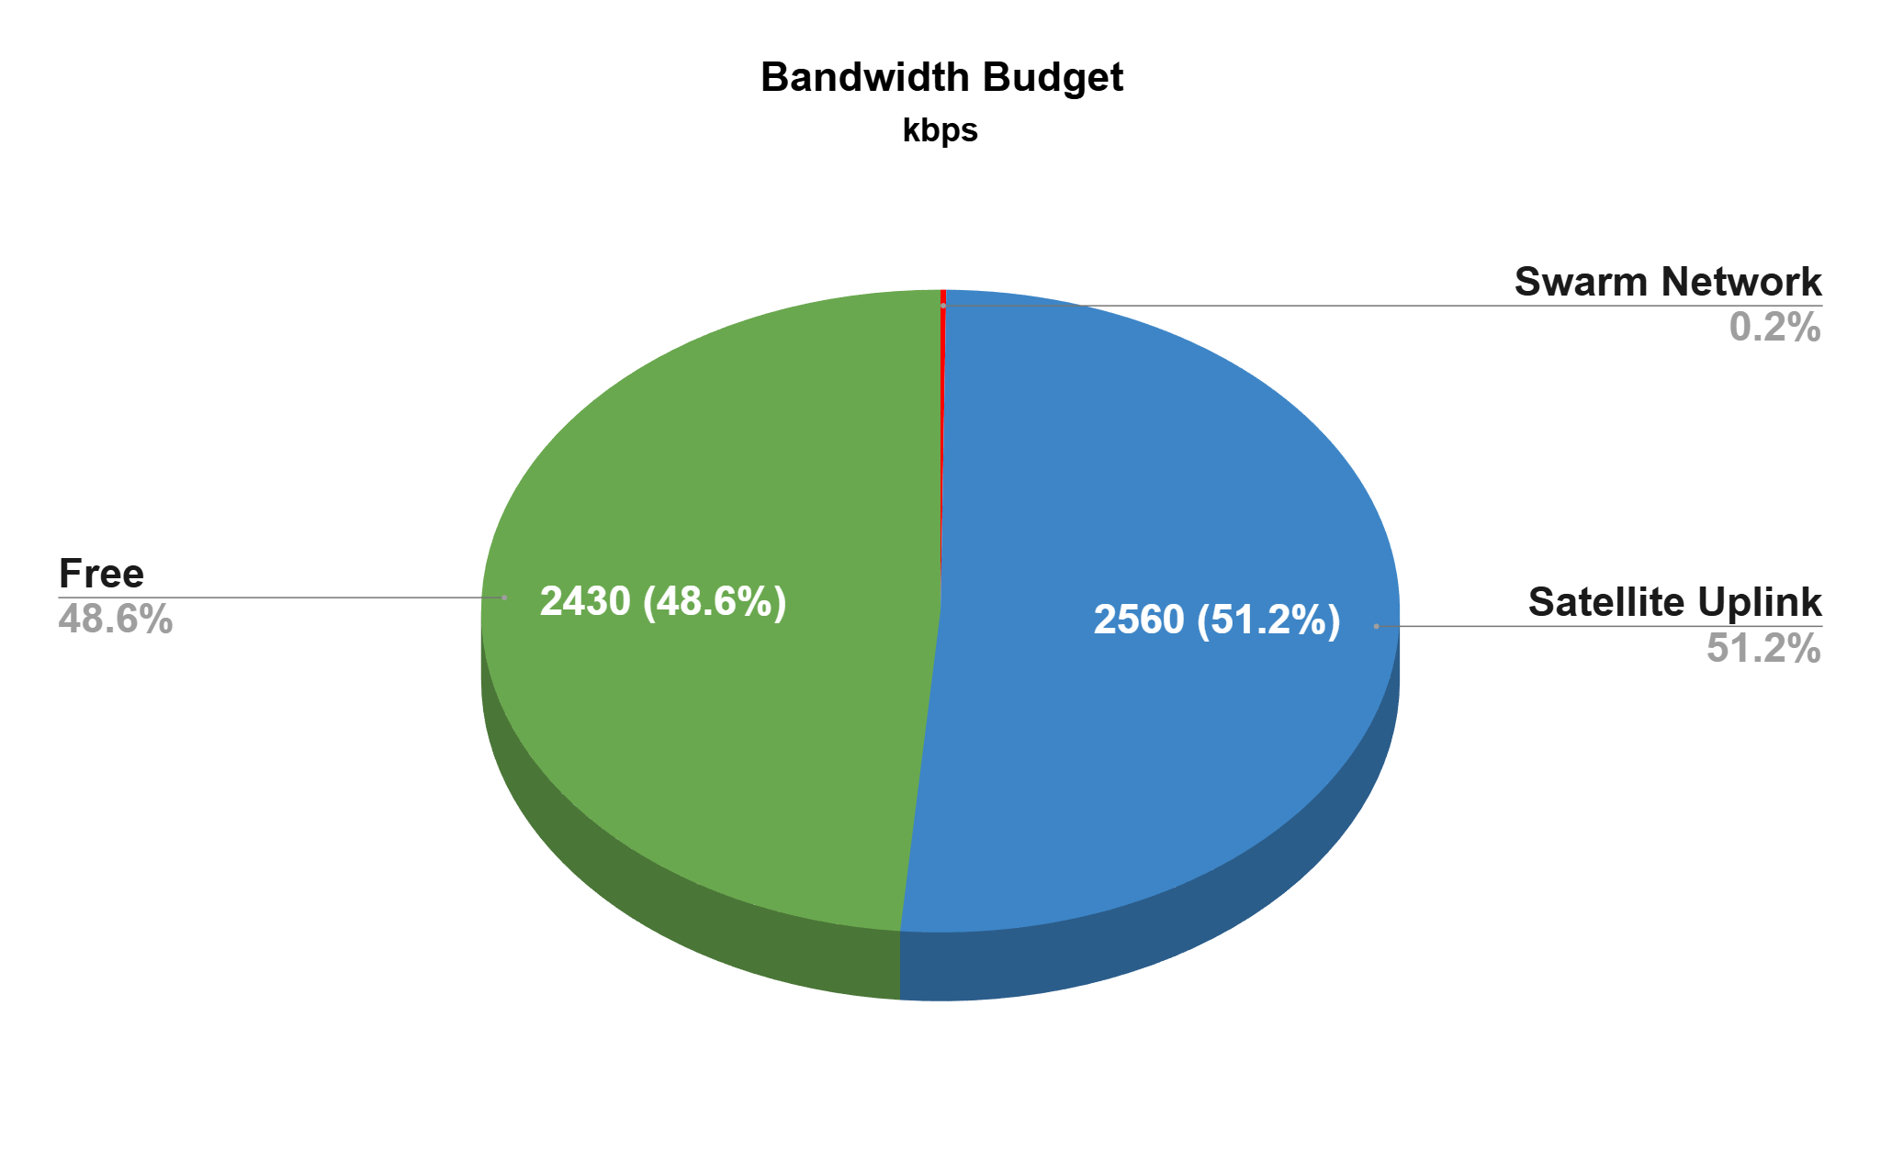
Performance & Bandwidth Analysis
Link Budget
Link Type | Available Capacity | Required Load | Margin / Status
Swarm Network (ESP-NOW) | ~1,000 kbps | 10 kbps (2 Drones) | 99% Free (Highly Scalable)
Satellite Uplink (Starlink) | ~5,000 kbps | 2,560 kbps (Video + Telemetry) | ~50% Free (Video Quality Safe)
10 (0.2%)
Notes:
John

Slide 34
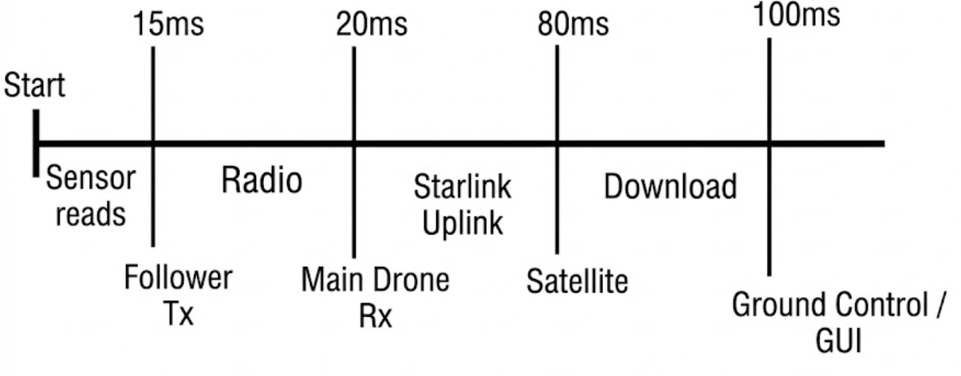
Data Protocol & Latency
Protocol Stack Definition We utilize distinct protocols for the local swarm versus the global uplink to optimize for speed and reliability.
  Swarm Link: ESP-NOW
  Video Uplink: WebRTC
  Telemetry: MQTT
Data Payload (The Packet)
  Format: Packed Binary Struct (64 Bytes).
  Content: [Nav Data] + [Sensor Readings] + [Battery Status].
  Efficiency: 10x smaller than standard JSON, reducing airtime collision risk.
Notes:
John

Slide 35
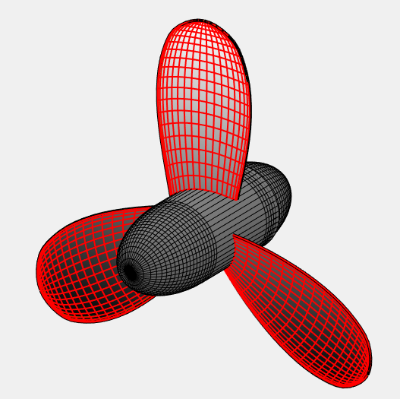
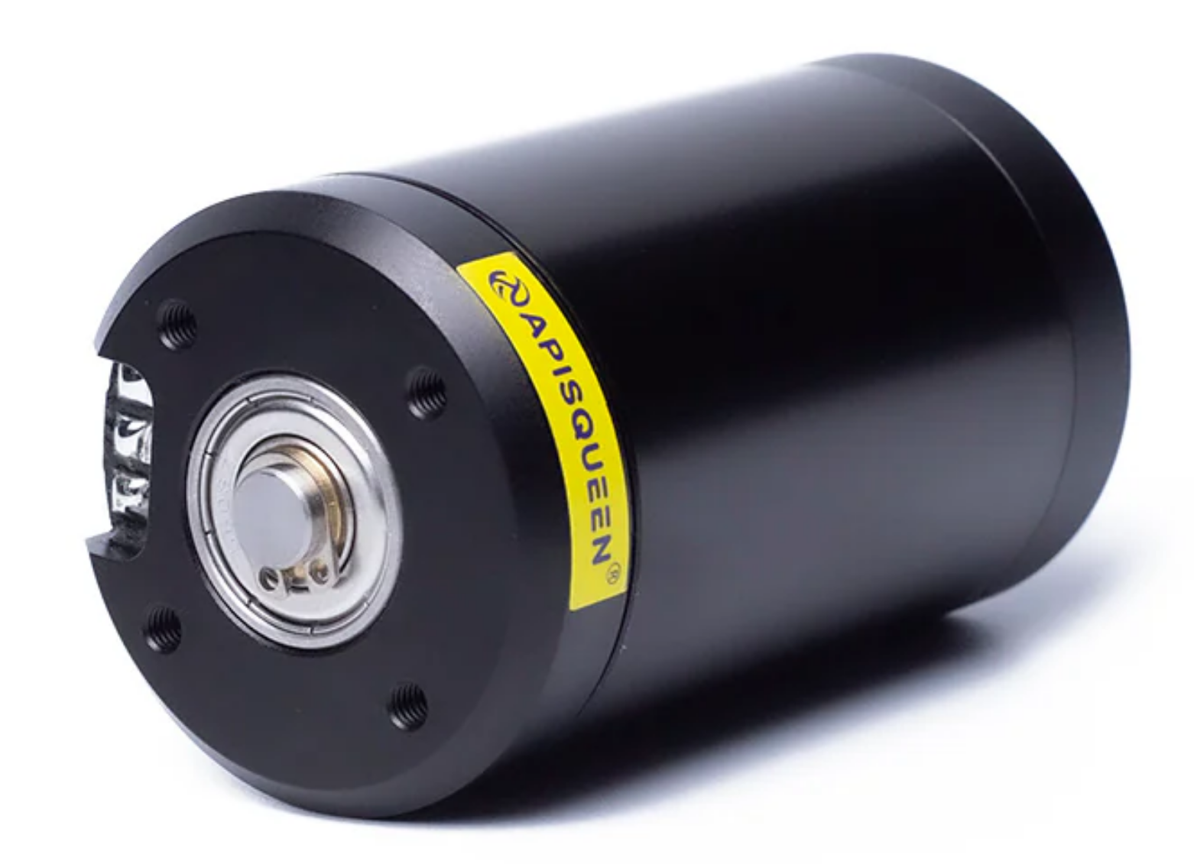
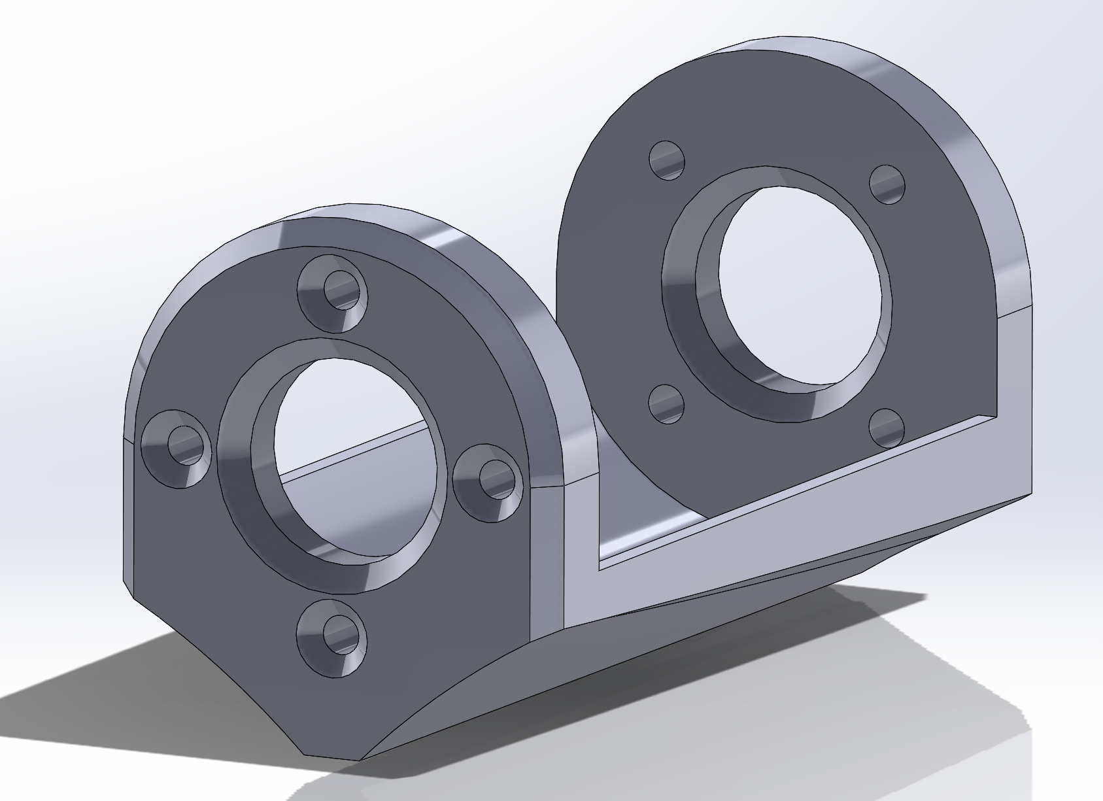
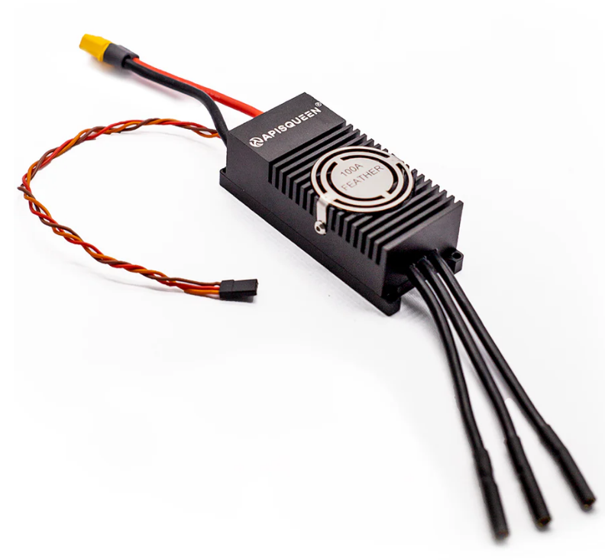
Propulsion Subsystem
Propeller
Motor Mount
Motor
2400 RPM
24V
24V
Power from Battery
Data Connection
Control signal from ESP32
Power Connection
ESC
Notes:
Robert

Slide 36
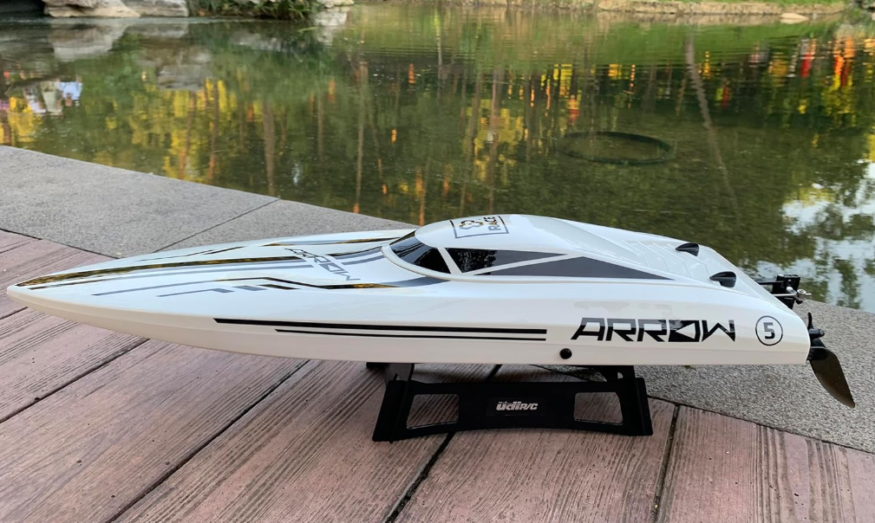
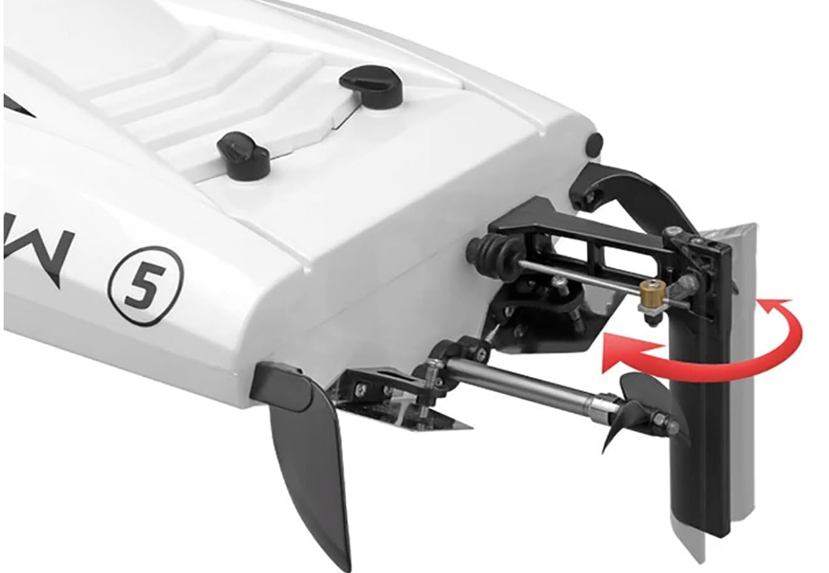
RC Drone Specifications
Key Features:
Can hold ESP32 and Jetson Nano for data transmission
Reaches 45 km/h
Waterproof
Brushless Motor
Watercooled System
190 min charging time
7 minute run time
Notes:
Used purely to demonstrate swarm abilities. $1700 cheaper than using 2025 hull
Images from https://www.amazon.com/-/es/Ssccgym-UDI005-escobillas-funciones-completas/dp/B0DRNNY597
Notes:
Robert

Slide 37
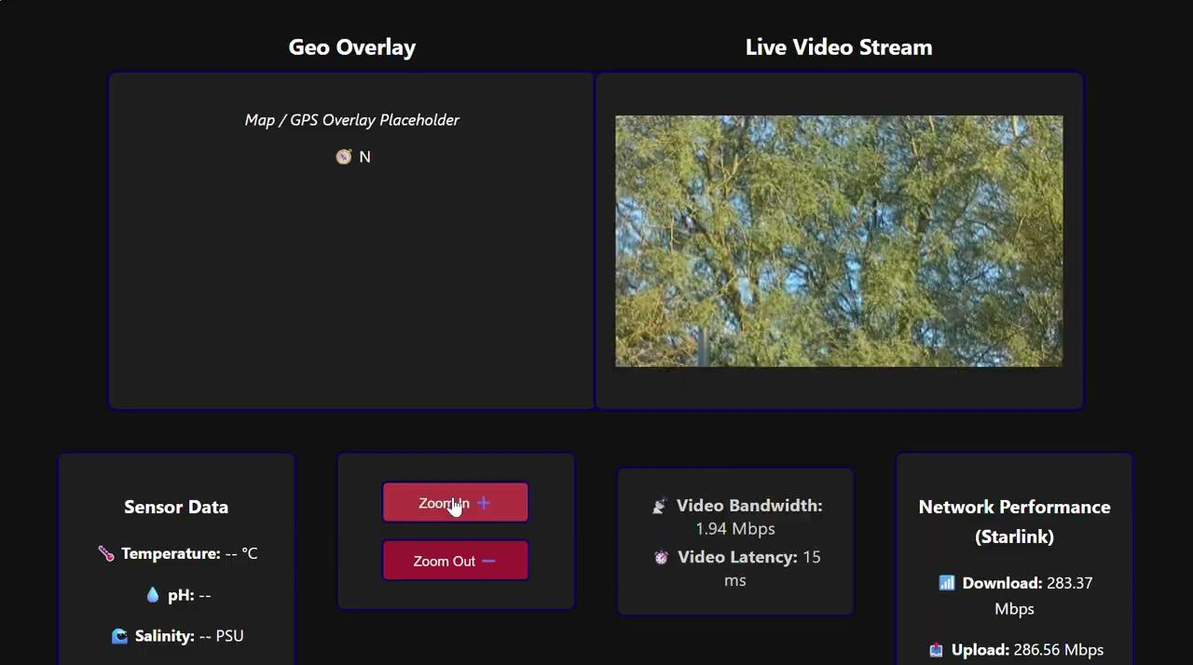
GUI with Sensor Data and Live Footage
ESP32
Jetson Orin Nano
Temperature
Sensor
Camera
(Surface)
Salinity Sensor
PH Sensor
Starlink Antenna
Starlink Terminal
Laptop
Internet Connection
Live-video
Streaming
GUI
GEO- Overlay
Notes:
Jamie

Slide 38
Performance Analyses and Expectations
Notes:
Alex

Slide 39

Propulsion Expectations
PDR:
Hull Speed: Maximum speed a hull can reach before the bow wavelength equals the boat’s length
→ Very large increase in wave drag
L_WL is the waterline length in feet
v_hull (3.2 ft.) = 2.4 kn
Target cruise speed: 5 kn
CDR:
Target cruise speed: 2.5 kn
Notes:
Alex

Slide 40
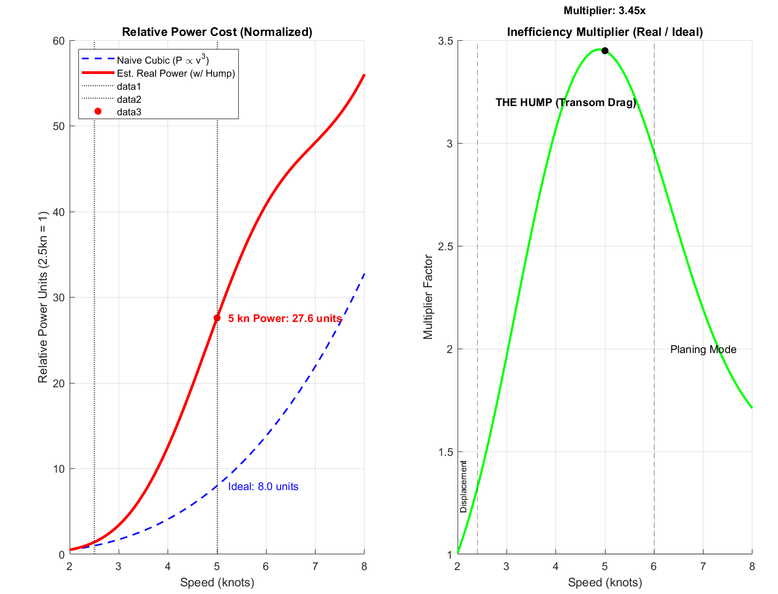
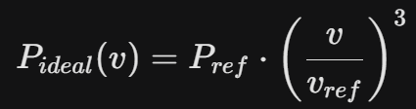


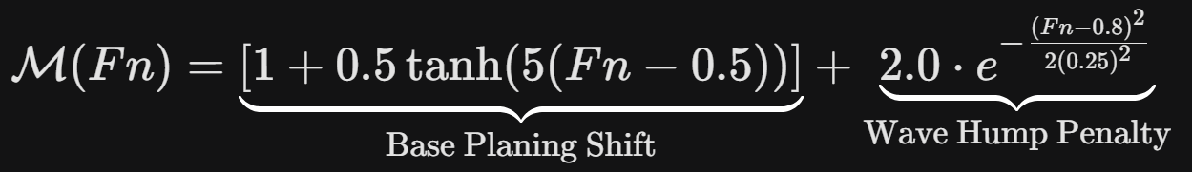
Propulsion Expectations
Accounting for wave drag (2.5 to 5 kn)
8x increase (ideal) vs ~28x increase (real)
Notes:
Robert

Slide 41
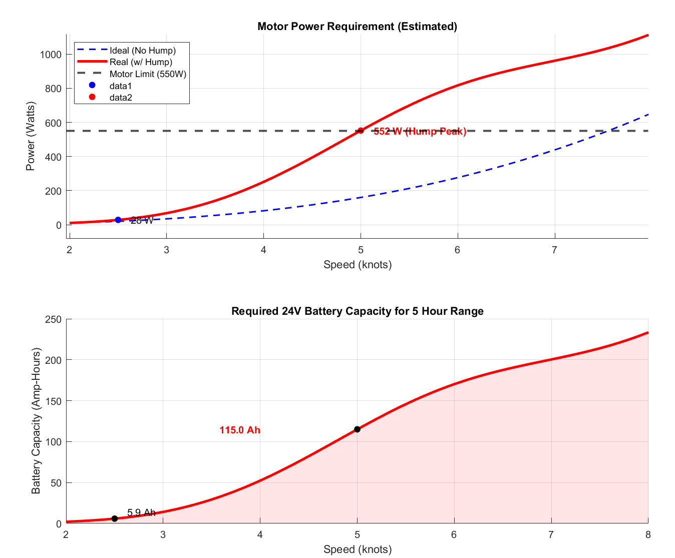
Propulsion Expectations
Top graph: Power to motor to achieve cruise speed
Difference between ideal and real model predictions
Bottom graph: Battery capacity required to achieve 5 hour range
Only ‘motor range’
Ideal case, assuming propeller efficiency = 1
115 Ah battery for 5 kn
6 Ah battery for 2.5 kn
  Double battery capacity for same distance traveled: 12 Ah total
10x Decrease in Ah required
(ideal)
Notes:
Robert

Slide 42
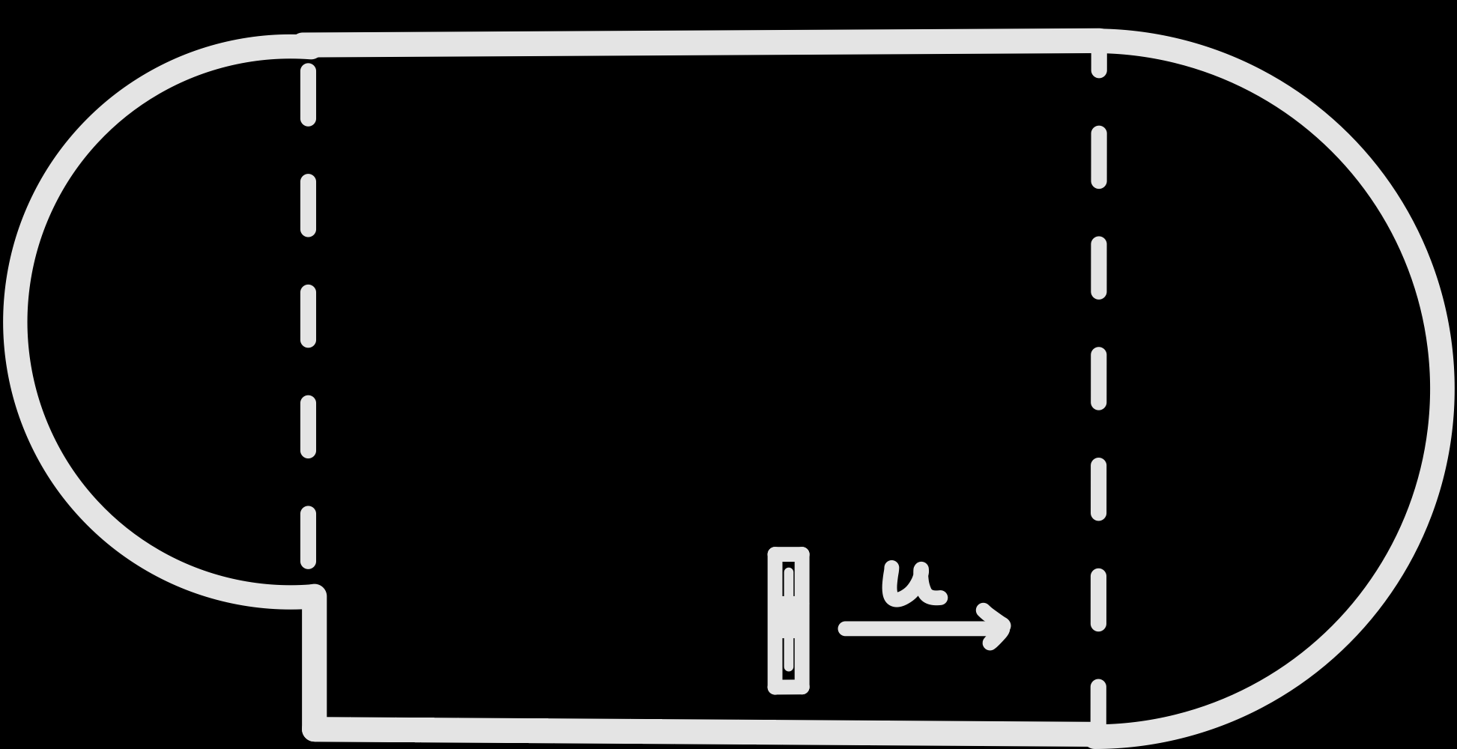
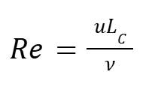
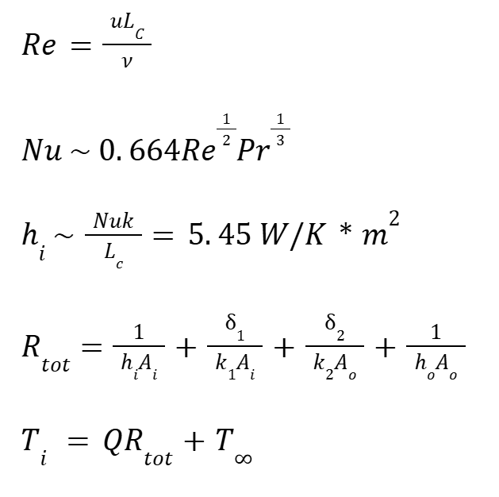
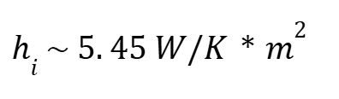
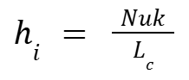
Heat Analysis
Assumptions:
AQUABOT modeled as two hemispheres and a cylinder (a large curved object for external convection)
Small Jetson Orin fan forces internal convection slowly, comparable to flow over a flat plate
AQUABOT operating stagnant, at steady state
Radiation neglected
Each wall layer is modeled as thin
Standard values for conductive coefficients of dense fiberglass and marine rubber/plastic coating
{
Image of AQUABOT Hull Approximated Geometry
Notes:
Kama

Slide 43
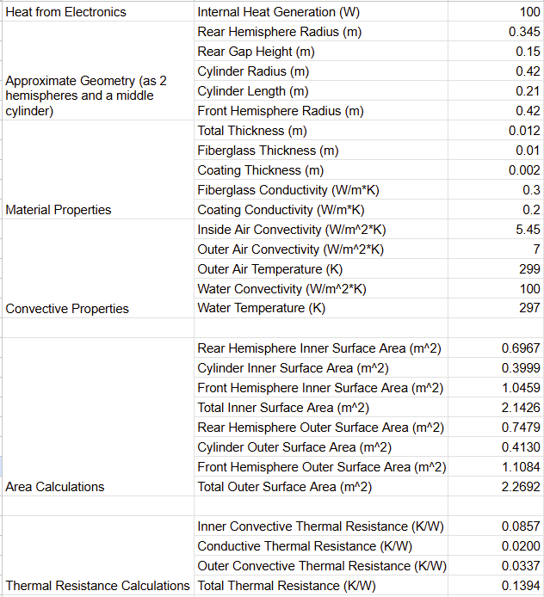
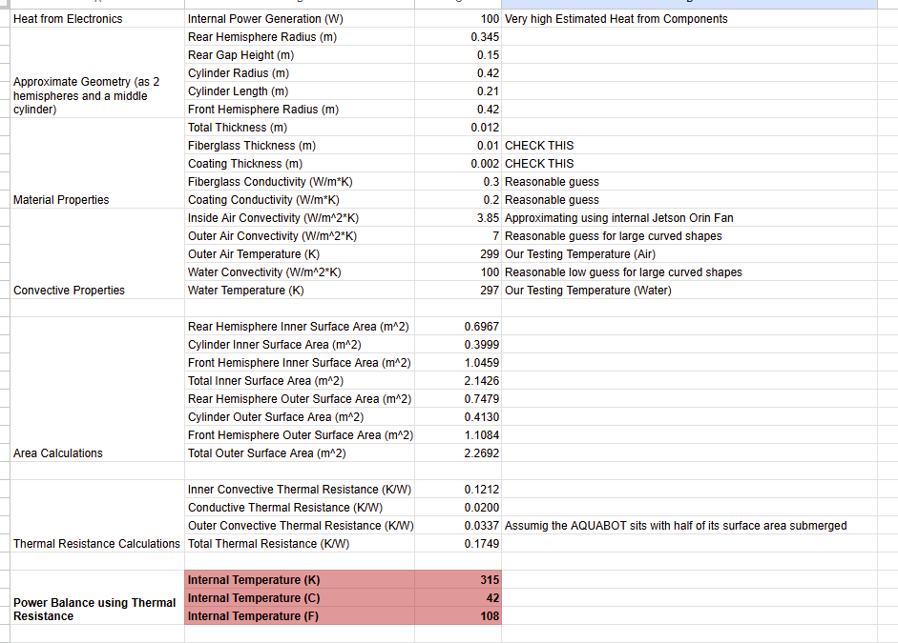
Heat Analysis
Conservative Estimate:
Internal convection coefficient dominates behavior
Further testing with cooling fan is required for more accurate estimation of internal flow speed
Overall, final temperature is towards high end of electronics operating threshold
{
Table with Heat Transfer Parameters and Calculated Values
Notes:
Kama

Slide 44
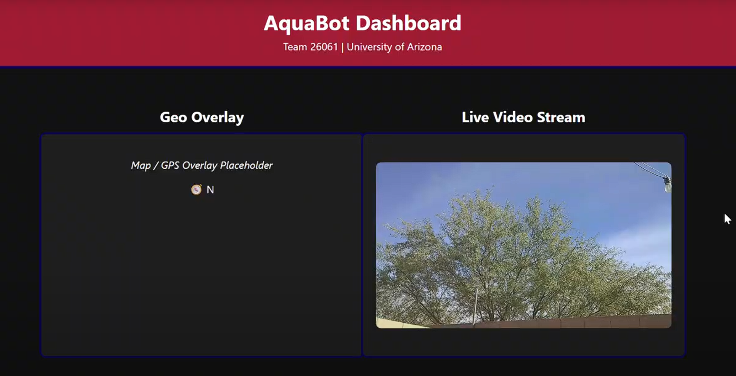
GUI and Ground Station Data Expectations
Sensor Data:
All data syncs every 10 seconds (minimizes bandwidth used for data transmission)
Temperature and GPS data integrated to create GEO-overlay for data visualization
CSV file viewable to show location-based data for temperature, pH, and salinity.
Saved onboard and on ground station GUI
Camera Data:
Saved onboard and on ground station
Livestream on GUI dashboard, with saved footage accessible
Notes:
Jamie

Slide 45
Verification
Notes:
Alex

Slide 46
Verification Overview
Step 1: Verify Individual Function of All Electronics:
Starlink✅
ESP32✅
Jetson Nano✅
Sensors ☑
IMX219 (Camera)✅
Motors
Servos
Step 2: Verify Individual Function of All Electronics Inside Hull & Hull Qualities:
5.1.3 Stability: Each drone shall self-right and maintain operational orientation.
5.3.2 Waterproofing: Each drone shall meet IP68 ingress protection standards. Components shall be tested in 1.5 m depths to ensure compliance.
Step 3: Verify Swarm Capabilities
5.1.2 Swarm Control: All drones shall self-right and enter operational state in 60s.
5.4.1 Autonomy & Control: Each drone shall support autonomous navigation and remote operator control.
5.1.4 Speed: Each drone shall sustain a threshold speed of 2.5 kts in calm water conditions, with an objective speed of 5 kts.
✅= Fully Verified, ☑ = Partially Verified
Notes:
Jamie

Slide 47
Detailed Verification Plan
5.4.2 Verification Procedure: Mesh Network Relay Test
Objective: Verify that the ESP-NOW Managed Flooding Mesh successfully routes telemetry from a "Follower" drone to the "Leader" drone via an intermediate "Relay" drone when a direct link is unavailable.
Requirement Verified: 5.4.2 Inter-Drone Communication (Multi-hop capability).
Success Criteria: Leader receives telemetry packets from Follower with a latency of < 200 ms despite no direct Line-of-Sight (LOS).
Step | Action | Expected Result | Pass/Fail
1 | Power on all 3 nodes (Leader, Relay, Follower) in close proximity (1m). | Leader Serial Monitor shows telemetry from "Follower" (Direct Link). RSSI > -50 dBm. | ☐
2 | Move "Follower" node to a distance of 100m OR place inside a metal RF shield, leaving only the "Relay" node in range. | Direct link is broken. Leader temporarily stops receiving Follower data. | ☐
3 | Position "Relay" node at the midpoint (150m) between Leader and shielded Follower. | The Mesh Logic activates. Leader resumes receiving telemetry from Follower. | ☐
4 | Inspect the received packet header on the Leader. | Packet shows Hop_Count >= 1 (indicating it passed through a relay). | ☐
5 | Measure Latency (Time Sent vs. Time Received). | Latency remains < 200 ms for the hopped packet. | ☐
Notes:
John

Slide 48
Detailed Verification Plan
5.1.6 Verification Procedure: Data Collection Test
Objective: Verify that all temperature, salinity, and pH data collected is reliably saved onboard and transmitted to ground station, as well as camera footage being at 1080p, 30 fps.
Requirement Verified: 5.1.6 Data Collection.
Success Criteria: All data collected is accurate and adequately displayed
Step | Action | Expected Result | Pass/Fail
1 | Test all three sensors in a liquid of known qualities. (Not transmitted via Starlink) | Data collected matches known values | ☐
2 | Retake data with transmission to GUI via Starlink | GUI data matches known values | ☐
3 | Connect camera to GUI and onboard storage, inspect saved data. | Saved data matches and is accessible via GUI | ☐
4 | View stored data on ESP32 via connection to monitor and stored data on GUI | Stored data demonstrates equivalent values per timestamp | ☐
5 | Test and modify GUI for usability and interpretation of data | GEO-overlay accurately displays data in a user-friendly manner, all data is easily accessible. Camera live stream and review is functional. | ☐
Notes:
Jamie

Slide 49
Detailed Verification Plan
5.4.6 Verification Procedure: Swarm Control
Objective: Successfully communicate position data and maintain formation within the specified timing constraints (<1s latency & >= 1Hz update)
Requirement Verified: 5.4.6 Swarm Control
Success Criteria: The swarm shall maintain coordinated network behavior through a leader-follower model executed via Jetson Mission Computer and MQTT topics. Each drone shall publish and subscribe to swarm state messages at ≥ 1 Hz with < 1 s latency.
Step | Action | Expected Result | Pass/Fail
1 | Initialize Swarm Network: Each drone connects to the MQTT broker, and verifies communication with the Jetson Nano. | Ground station receives communication from both Drone IDs via MQTT; Link Quality > 50% | ☐
2 | Establish Leader-Follower Roles: The leader drone publishes its state and navigation cues, while follower drones sync. | Follower drones successfully identify the Leader ID, switch to following state, and begin mirroring the Leader’s heading and velocity in 1s or less. | ☐
3 | Exchange Swarm State Messages: All drones publish and subscribe to swarm state topics at ≥1 Hz, ensuring message latency stays under 1 s. | Telemetry logs confirm that packets form every Drone ID appear in the swarm/state topic at intervals of <= 1s (>= 1Hz). Timestamp shows the delay between sent and received time is consistently less than 1s. | ☐
4 | Coordinate Navigation: Using GPS data, each drone adjusts its path to maintain formation and avoid collisions while following trajectory. | Follower drones autonomously adjust motor thrust/yaw to maintain target separation distance from the Leader. Visual observation and GPS tracks confirm drones move in parallel paths without colliding. | ☐
5 | Collect Data: Each drone gathers environmental data and publishes it to the swarm network for processing. | Ground station compiles a unified dataset containing sensor readings from all distinct Drone IDs. The aggregated file shows no data gaps larger than 3 seconds and timestamps are synchronized | ☐
Notes:
John - mention where test will be conducted

Slide 50
Risk Analysis
Notes:
Robert

Slide 51
Risk Analysis
Impact | 5
 | 4 |  | R002 | R003 | R001
 | 3
 | 2 |  | R004 | R005
 | 1
 |  | 1 | 2 | 3 | 4 | 5
 |  | Likelihood
ID | Risk Description | Severity (L x I)
R001 | Integrating all software components | 16
R002 | Hull fragility due to modification | 8
R003 | Lack of software knowledge | 12
R004 | Assessing capabilities of smaller drones | 4
R005 | Modifying pre-manufactured drones | 6
Impact | Likelihood
5 - Catastrophic | 5 - Near Certainty
4 - Major | 4 - Highly Likely
3 - Moderate | 3 - Likely
2 - Minor | 2 - Somewhat Likely
1 - Insignificant | 1 - Not Likely
 | High Risk
 | Moderate Risk
 | Low Risk
Notes:
Robert

Slide 52
Risk Analysis: Mitigation Plan
R001 (high): Integrating all software components
Consult with experts and use university resources
  Find out where problems lie early
Plenty of tests to ensure successful results
  Correct input-output mapping
R002 (medium): Hull fragility due to modification
Talk to Eddie’s Marine Equipment to learn correct modification methods
Investigate alternative mounting solutions (no hull modification)
Conduct isolated hull testing post-modifications
R003 (medium): Lack of software knowledge (we don’t know what we don’t know)
Use of AI as a guide to find surface level flaws
Consult with experts and use university resources to further improve/ final check
Notes:
Robert

Slide 53
Project Status & Plan
Notes:
Jamie

Slide 54
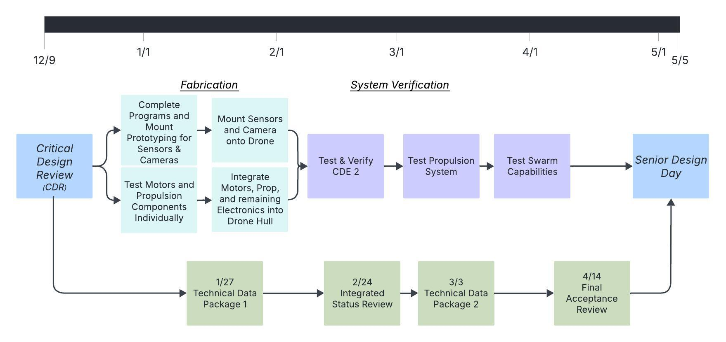
PERT Chart
Notes:
Jamie - CDR, Test CDE2, Swarm Capabilities Testing, and ISR (RESOLVED)

Slide 55
Critical Design Element 1
Notes:
Mayra

Slide 56
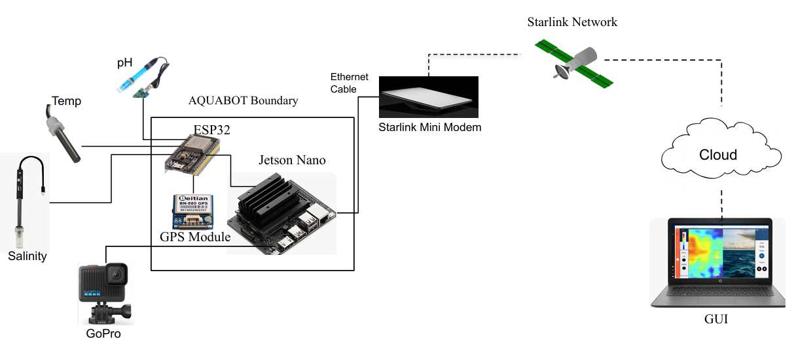
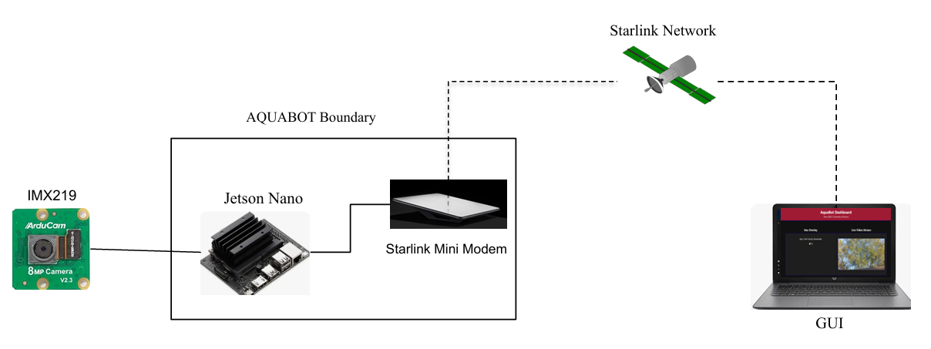
Critical Design Element (CDE-1)
CDE1 demonstrates reliable two-way data communication between AQUABOT and the ground GUI via Starlink/Wi-Fi, enabling both real-time data transmission and remote command.
✅ CDE1 Verified: Demonstrated reliable two-way data communication via Starlink uplink and GUI dashboard.
Replaced GoPro Hero 7 Black with IMX219
  Lower power
  Lower latency
  CSI
Removed Geo Overlay, will be integrated later due to time constraints
  Didn’t affect CDE1
PDR
CDR
Notes:
Mayra

Slide 57
Expected Video Bandwidth for AquaBot Live Stream
(1080p H.264 WebRTC)
Raw Video (Uncompressed) Bandwidth
We start with the raw camera output:
Raw bitrate =
1920x1080×30fps×24 bits =
1,492,992,000 bits/sec ≈
1.49 Gbps uncompressed
Camera Resolution & Encoding
Sensor: IMX219 (Raspberry Pi v2 camera)
Resolution: 1920×1080 @ 30 FPS
Codec: H.264 (NVIDIA hardware encoder)
Streaming Protocol: WebRTC (real-time, low-latency)
Expected bandwidth for AquaBot
For real testing in the ocean:
Scenario Expected
Calm Ocean 2.3 Mbps
Moderate waves 3.5 Mbps
Rapid motion 5.8 Mbps
* Plus 0.25 Mbps for control + telemetry
Equation used to Estimate bandwidth for 1080p H.264 WebRTC :
Bitrate=bpp⋅Resolution(W)⋅Resolution(H)⋅fps
Target Bitrate=Bitrate⋅(1+Overhead)⋅α
*Overhead = protocol + header overhead (≈ 0.10)
*α = safety margin (≈ 0.85 for adaptive streaming)
Max Expected Bandwidth ≈ 6 Mbps
Based on validated H.264 encoding practice for 1080p30 video across varying motion complexity:
Calm ocean (low motion): bpp ∈ [0.03, 0.05]
Moderate waves (medium motion): bpp ∈ [0.05, 0.08]
Rapid motion (high motion): bpp ∈ [0.08, 0.12]
Notes:
Mayra

Slide 58
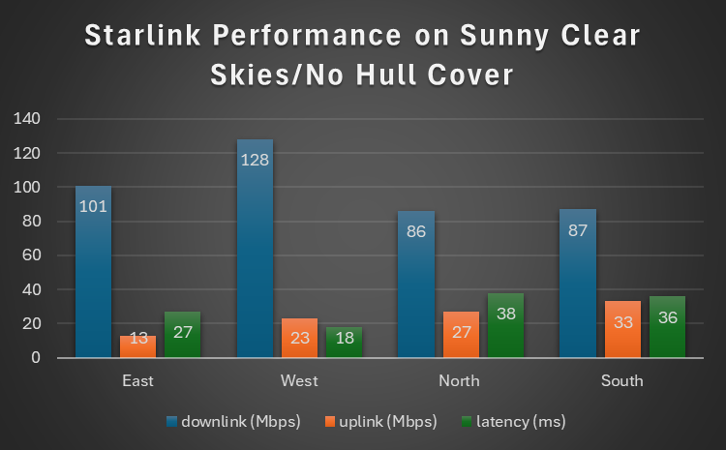
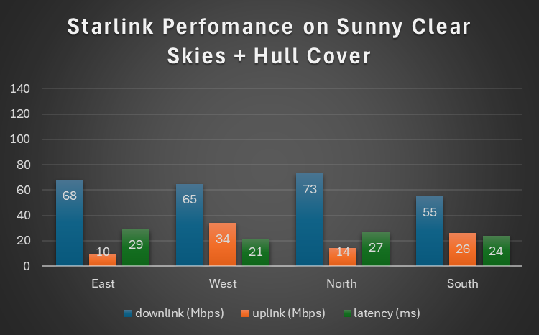
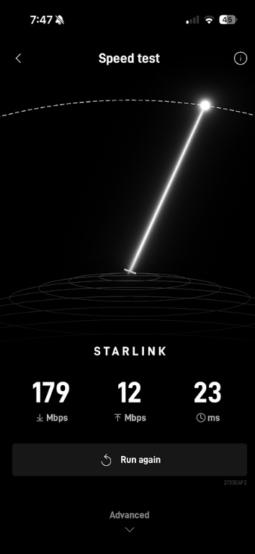
Starlink Analysis
Speed test from Starlink App
We tested in a neighborhood with lots of Wi‑Fi and signals, so it’s a worst‑case scenario.
Out on the ocean there are no houses or obstacles, so interference is much lower.
Performance in deployment will be stronger than what we measured here.
Maritime Service - Open Ocean/Stronger signal and consistent throughput.
Worst case scenario: Uplink:10 Mbps
Downlink: 55 Mbps
6 Mbps < 10 Mbps
Notes:
Mayra

Slide 59
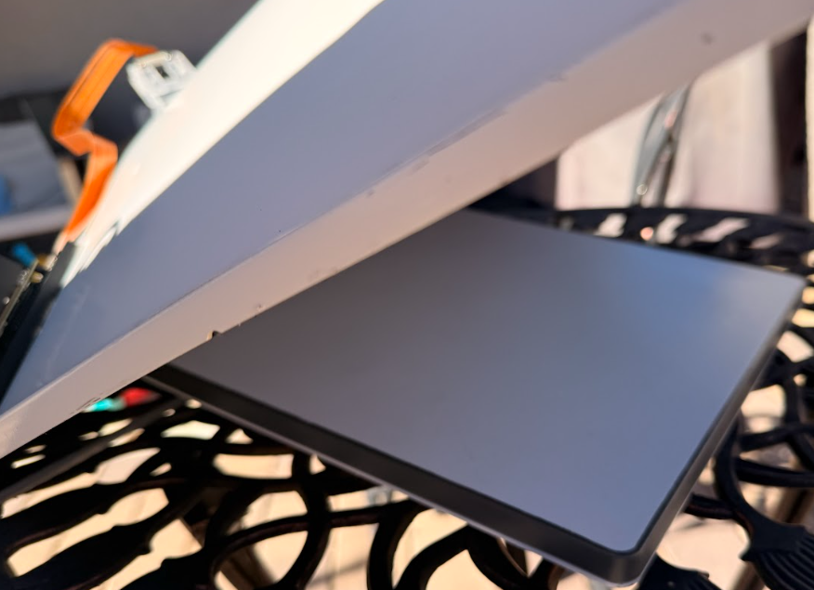
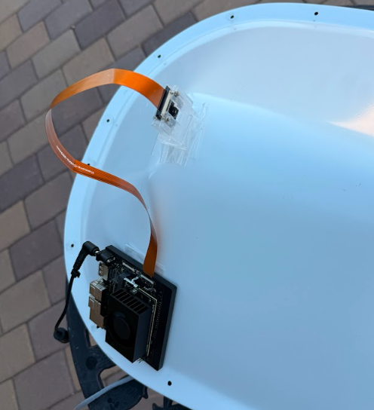

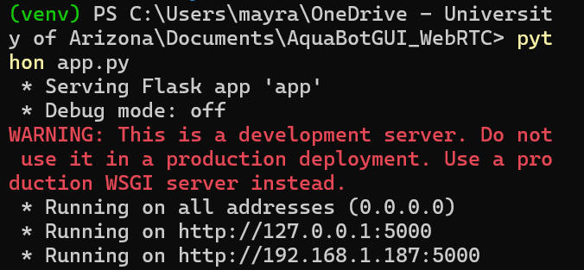
Verification Setup: Starlink + GUI Streaming Test
1. Jetson auto boots when connected to power
2. Place Starlink under hull top
3. Run signaling_server.py & app.py on terminal
5.
Go to http://192.168.1.189:5000
6. Verification checklist :
Recording triggered and saved locally on Jetson
Zoom commands received and executed
Run Iperf Test
GUI commands updated in real time
Notes:
Mayra

Slide 60
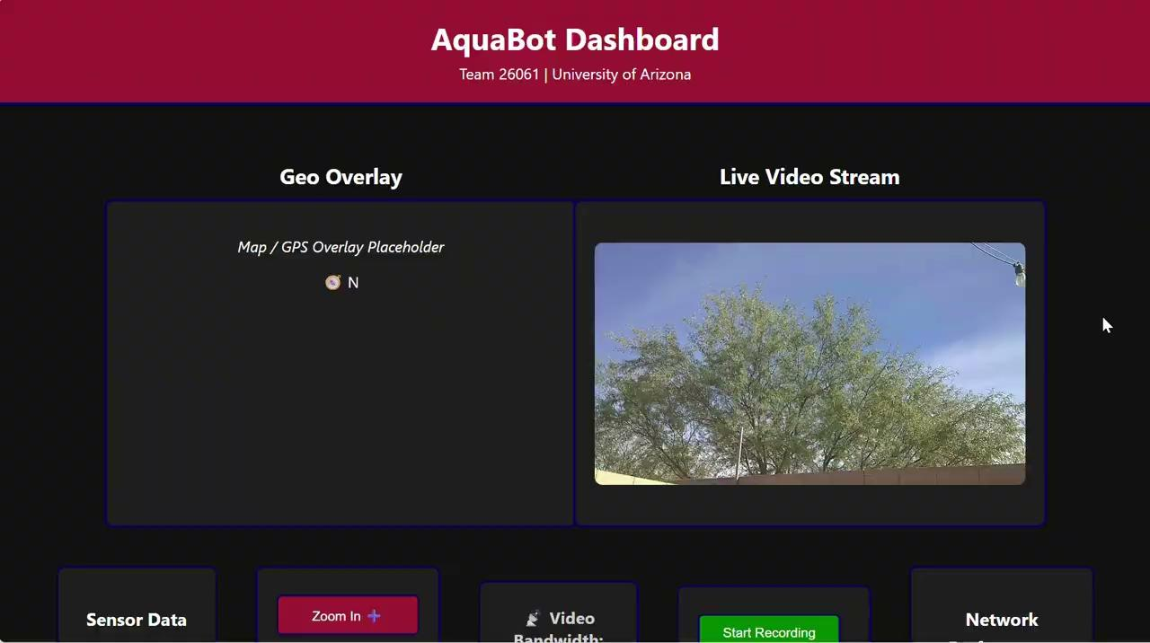
Live GUI Demo
Dashboard Specs:
Video Bandwidth and video latency
Iperf / Network Testing
Start recording/ stop recording
Half geo overlay (placeholder) / half video streaming.
Sensor data
Test conducted Nov 30, 2025 — Starlink + Jetson Orin Nano + Flask GUI
Notes:
Mayra

Slide 61
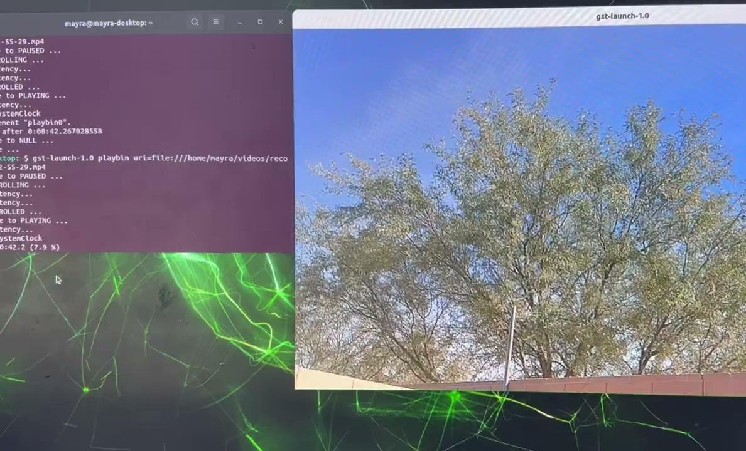
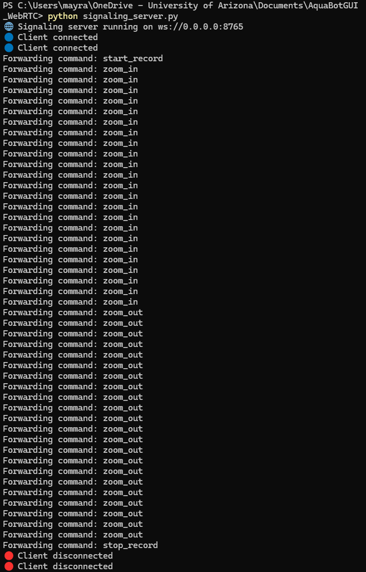
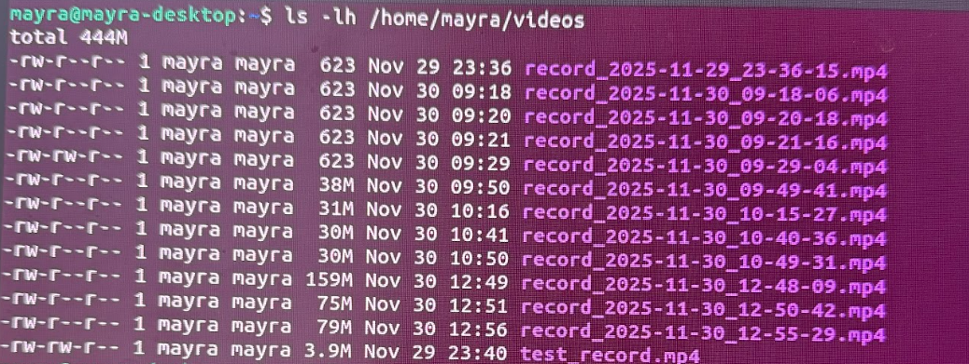



Verification
On GUI/ Laptop
On Jetson Orin nano Monitor
Demonstrates:
Two-way communication
Recording
Saved Video files at 1080p @ 30fps
From GUI:
Video Bandwidth:
1-2 Mbps
Video Latency:
>20 ms
Jeston Orin Nano:
Storage 256GB
Notes:
Mayra

Slide 62
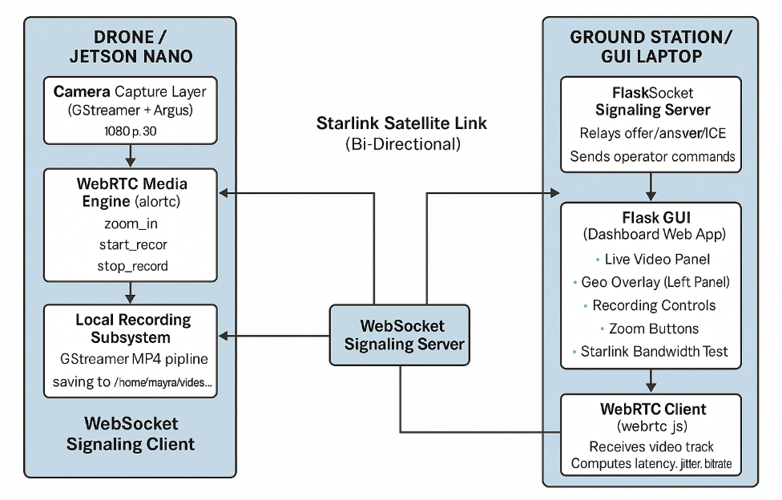
GUI Software Architecture
Backend Scripts:
webrtc_jetson.py - Camera capture + Media Engine + Signaling
  record_start.sh/ record_stop.sh - Local video recording
autostart.sh - Launches Jetson service automatically on boot
Frontend Scripts:
signaling_server.py - Initial handshake + commands
app.py - Flask server + display logic
  Index.html -GUI layout
webrtc.js - WebRTC Client (video stream + operator commands)
Notes:
Mayra

Slide 63


CDE 1 Results
5.4.4 Satellite Uplink: Each AQUABOT drone shall independently transmit live and stored data to a remote ground station via its onboard Starlink.
5.1.6 Data Collection: Each AQUABOT drone shall measure temperature, salinity, pH, and capture visual imagery at a minimum of 1080p resolution, 30 fps.
  Verified: IMX219 camera streaming at 1080p/30fps
5.4.5 Display: The display shall show half the display with Geo-overlay and the other half will display live-streaming.
  Verified: GUI layout splits display as required/ half live video streaming.
5.4.1 Autonomy & Control: Each AQUABOT drone shall support both autonomous navigation and remote operator control via a satellite-based waypoint system.
  Verified: Remote control via GUI confirmed.
Verified
Partially Verified
Notes:
Mayra

Slide 64
CDE1: Risk and Complexity + Next Steps
CDE-1 validated reliable two-way communication on Starlink; next phases extend to multi-network.
Risk:
System Complexities:
Two-network WebRTC
ICE/NAT traversal
Starlink routing fluctuations
Added data flows (video + telemetry + commands)
Risk | Cause | Impact | Mitigation
WebRTC fails across two networks | NAT/ICE candidate rejection | Loss of remote command/video | Add TURN/STUN server, test different relay configs
Starlink connection interruptions | Satellite acquisition / weather | Increased latency, packet loss | Add buffering, dynamic bitrate (WebRTC)
Bandwidth variability | Starlink uplink fluctuations | Lower video quality | Adaptive bitrate + video fallback
Sensor + video concurrency | Multiple data channels | CPU/Network load | Prioritize RTP stream, stagger telemetry
Next Step:
TURN server addition
Remote testing
Geo-overlay
Full sensor integration
CDE-2 prep
*High Risk
Notes:
Mayra

Slide 65
Critical Design Element 2
Notes:
Mayra

Slide 66
Critical Design Element (CDE-2)
Builds from CDE-1 two-way communication:
Integrates system into hull with waterproofing
Verifies system functionality within hull
Transmits all sensor data in addition to camera live stream
Key Steps:
Finalize mount prototypes
Waterproofing of camera and sensor electronics
Safely connect and organize electronics within drones (ESP32, Jetson Nano, Starlink)
Programming of GUI
Objective:
CDE-2 will demonstrate sensor and camera connectivity to the ground station GUI, while being integrated into the drone hull itself.
Notes:
Jamie

Slide 67
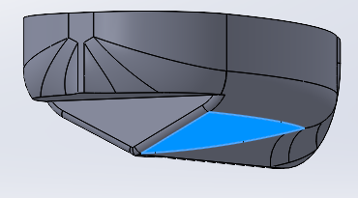



Sensor and Camera Mounts
Sensor Mount:
External mount with hole for wires to connect to internal ESP32 in hull
Recesses to fit temperature, salinity, and pH sensors, with space for wire storage in back.
Arch can be modified to fit onto RC boats
3D printed with silicone coating and o-rings
Room for additional sensors
IMX219z Mount:
Holds camera in place above drone
Slit allows for wiring to occur within the drone.
3D printed with silicone coating and transparent material to protect camera
Notes:
Jamie

Slide 68



Critical Design Element (CDE-2)
Single camera mount above, sensors mounted below
Notes:
Jamie

Slide 69
Critical Design Element (CDE-2) Verification
Procedure:
Place hull into pool of water of known temperature, salinity, and pH. Ensure sensors, camera, ESP32, Jetson Nano, and Starlink are all powered on and connected to ground station.
From ground station, ensure that sensor data is updating every 10 seconds, and camera is streaming at 30 fps and 1080p.
Compare sensor data to known data values for water.
Risks:
Waterproofing
Sensitivity, longevity of sensor run time
Heat from drone affecting sensor values
Components needed:
Temp, pH, and salinity sensors
IMX219 Camera
ESP32
Jetson Orin Nano
Starlink
Ground station monitor and keyboard
Hull
Mounts and mounting materials
Notes:
Jamie

Slide 70

Requirements Verification
5.1.6 Data Collection: Each AQUABOT drone shall measure temperature, salinity, pH, and capture visual imagery at a minimum of 1080p resolution, 30 fps.
  Sensor + camera integration
5.4.5 Display: The display shall show half the display with Geo-overlay and the other half will display live-streaming.
  Confirms usable internal volume for all subsystems
5.2.4 Payload Mounts: The hull shall provide standardized, sealed mounts for Starlink terminal, battery, and sensor payload.
  Shows standardized sealed mounts in practice
5.3.2 Waterproofing: Each aquatic AQUABOT drone shall meet IP68 ingress protection standards IAW IEC 60529:1989 + AMD1:1999 CSV. Waterproof components shall be tested in 1.5 m depths to ensure compliance.
  Verifies waterproofing during integration sensor/camera operation
Verify with CDE2
Notes:
Jamie

Slide 71
Cost Analysis and Deliverables
Notes:
Jamie

Slide 72

Bill of Materials
* Printed or Machined Part
M Also includes monthly subscription
Notes:
Robert

Slide 73
Cost Analysis
Highest costs:
  Hull ($850)
  Starlink ($500)
  Battery ($360 *on sale)
    Lower range or speed
Not every drone needs a Starlink or Jetson Nano
  Based on BW, likely ⅓
  Average cost to $2000 per drone
* Printed or Machined Part
M Also includes monthly subscription
Notes:
Robert

Slide 74
Cost Analysis
Net Cost (tax + shipping): $2700
  Will go to one complete drone
Reserve Cost: $1300
  $800 for:
    Updates to 2025 Hull
    Testing
    Additional Materials
  $500 for:
    Any unforeseen costs
      Shipping, tariffs, etc.
* Printed or Machined Part
M Also includes monthly subscription
Notes:
Robert

Slide 75
Deliverables
Deliverable | Date | Description
Programmed Cameras and GUI | 12/9/2025 | Camera connected and linked to GUI
Programmed Sensor Suite | 12/9/2025 | Sensors and GPS integrated
Materials CAD | 12/9/2025 | CAD for all major systems complete
Mounted Cameras | 1/2/2026 | Equipped with both storage and streaming abilities.
Communication Module | 1/22/2026 | Starlink integrated with all components & GS.
Propulsion System | 2/5/2026 | Functional propulsion system w/ motor control
Operational Ground Station | 2/19/2026 | GUI and backend for live data transmission
Functional Hull Prototype | 3/5/2026 | Hull integrated with all components
Manual | 4/14/2026 | Includes documentation and user guides
Project Final Report | 5/5/2026 | Includes summary, system specs, and results
Notes:
Jamie

Slide 76
Summary
Notes:
Jamie

Slide 77
Summary
Key Features of Our System:
Integrated sensor suite (pH, salinity, temperature, 1080p camera).
Starlink-based communication for live video and data transmission.
Ground station with sensor data and camera livestream, as well as navigational control
Reusable, impact-resistant hull.
Swarm deployment and short-term ocean monitoring capability.
Critical Design Element (CDE-2):
Demonstrates data accuracy and live data display while sensors and camera are integrated into the hull.
Next Steps:
Finalize prototypes, begin hull fabrication and verification of performance requirements.
Notes:
Jamie

Slide 78
Questions & Discussion
Notes:
17

Slide 79
Appendix
Notes:
Jamie

Slide 80

Appendix
Parts and Drawings List

Slide 81

Appendix
24V Battery Drawing

Slide 82

Appendix
Motor Mount Drawing

